Slide 1
MDSR Capacity-Building Workshop

Slide 2
MDSR Capacity-Building Workshop
Welcome and Opening Remarks
Notes:
15-20 minutes, may need to include additional time depending on how many dignitaries, senior representatives are in attendance. May also need to extend time to allow for an opening prayer depending on the setting.

Slide 3
Day 1, Session 1
Overview of the workshop
MDSR Skills-Building Workshop

Slide 4
Session Objectives
Describe the training format
Explain how to use the learner’s guide

Slide 5

Goals of MPDSR Workshop
To strengthen manager and provider skills to support strong MDSR processes that contribute to facility and
sub-national efforts to improve the quality of maternal health care and eliminate preventable maternal deaths

Slide 6
Workshop Objectives
Identify and notify maternal deaths
Create and/or strengthen capacity of district/subnational and facility MPDSR or MDSR committees to implement MDSR processes
Review maternal deaths, assign cause of death using the ICD-MM and identify contributing factors
Define, implement and monitor responses based on individual death audits
Monitor and analyse trends in causes of maternal death and findings of death reviews over time, and define, implement and monitor a set of priority responses based on identified trends (at the facility and district/subnational level)

Slide 7
MDSR Module
Part of a set of aligned MPDSR guidance and capacity-building materials supported by the WHO, UNICEF, partners and members of the Global MPDSR TWG
Many sessions are relevant to overall MPDSR implementation regardless of type of deaths being reviewed
Complementary perinatal death surveillance response (PDSR)
capacity-building module can be added in settings where systems are integrated
Materials focus on subnational and facility-level implementation
Modules on community-level implementation can be developed and added to reflect the continuum of MPDSR that exists in different countries
Notes:
In discussing that these materials focus on subnational and facility-level implementation, facilitator can note that the analysis of trends is applicable across all levels
an aligned UNICEF-led PDSR capacity-building module available at https://www.healthynewbornnetwork.org/resource/skill-building-on-perinatal-death-reviews-a-facilitator-guide-and-resources/

Slide 8
Workshop Format
3-day workshop
Lectures, small group work, exercises
Lunch
Two breaks each day

Slide 9
Ice Breaker – “Whose fact is this?” (10 minutes)
Write down one interesting/unusual fact about yourself on a small piece of paper
Give that piece of paper to the facilitator
Introduce yourself to your colleagues, including the interesting fact that you jotted down on the piece of paper

Slide 10
Workshop Norms and Expectations
Populate the flip charts as a group

Slide 11
Discussion
Question and answer with learners
Notes:
Reference: WHO, 2012. The WHO application of ICD-10 to deaths during pregnancy, childbirth and puerperium: ICD MM. World Health Organization 2012
.

Slide 12
Day 1, Session 2
Individual Learning Plan and MPDSR Knowledge Assessment Pre-Test
MDSR Skills-Building Workshop

Slide 13

Session Objectives
Identify areas of MPDSR where they feel competent and where they require further instruction
Complete the MPDSR knowledge assessment pre-test

Slide 14
Individual Learning Plan:
Level of Competency Scale
Low | Topic is new or unfamiliar to the learner
Moderate | Learner is aware of the topic. Learner is knowledgeable but will benefit from additional education on the topic.
High | Learner is highly knowledgeable on the topic and may be able to provide additional insight during the workshop
Notes:
To go with the Individual Learning Plan

Slide 15
Exercise - Individual Learning Plan
Indicate whether you have “low”, “moderate” or “high” confidence for each Learning Objective
Return completed plan to the facilitator
Notes:
To go with the Individual Learning Plan

Slide 16
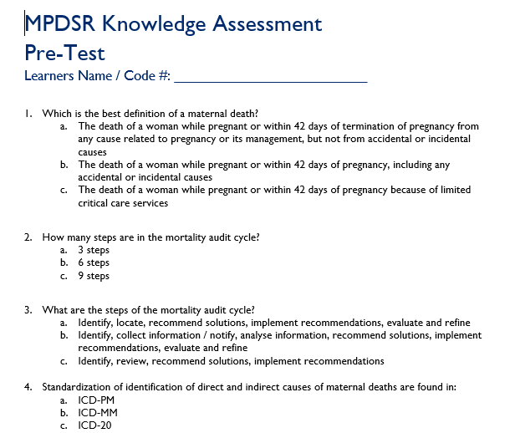
MPDSR Knowledge Assessment: Pre-Test
Write your name/number at the top of the pre-test
Complete the Knowledge Assessment Pre-Test
Return your completed test to the facilitator

Slide 17
Discussion
Question and answer with learners
Notes:
Reference: WHO, 2012. The WHO application of ICD-10 to deaths during pregnancy, childbirth and puerperium: ICD MM. World Health Organization 2012
.

Slide 18
Day 1, Session 3
Understanding Pathways to
Maternal Death
MDSR Skills-Building Workshop

Slide 19
Session Objectives
Describe the goals of a continual MPDSR process
Explain the three delays model

Slide 20
Maternal Mortality – Definition
Maternal mortality is the death of a woman while pregnant or within 42 days of termination of pregnancy, irrespective of the duration and site of the pregnancy, from any cause related to or aggravated by the pregnancy or its management, but not from accidental or incidental causes. (WHO 1999)
Notes:
Facilitator – Perhaps invite one participant to read the definition out loud to the group

Slide 21
Maternal Mortality Ratio (MMR)
This is the ratio of the number of maternal deaths during a given time period per 100,000 live births during the same time-period.

Slide 22
Global Causes of Maternal Mortality
Haemorrhage (27.1%)
Hypertensive disorders (14.0%)
Sepsis (10.7%)
Abortion (8%)
Embolism (3.2%)
Other direct causes (9.6%)
Notes:
Reference;
Lale Say, Doris Chou, Alison Gemmill, Özge Tunçalp, Ann-Beth Moller, Jane Daniels, A Metin Gülmezoglu, Marleen Temmerman, Leontine Alkema, Global causes of maternal death: a WHO systematic analysis, Lancet Global Health, Volume 2, No. 6, e323–e333, June 2014

Slide 23
Country Specific Mortality Data
Placeholder – Facilitator, please insert 1-2 slides with country-specific data

Slide 24
Example: Select Indicators
Maternal Care Indicators | Rate/Ratio
 | 2008 | 2015
Maternal Mortality
Delivery in a health facility
Causes of maternal deaths | %
Haemorrhage
Infection
Eclampsia
Unsafe abortion
Obstructed Labor
Malaria
Anemia
Others
Notes:
Note to facilitator – Please complete with country-specific data

Slide 25
How does the WHO define MDSR?
“A form of continuous surveillance linking the health information system and quality improvement processes from local to national levels. It includes the routine identification, notification, quantification, and determination of causes and avoidability of all maternal deaths, as well as the use of this information to respond with actions that will prevent future deaths”
Notes:
1. WHO, 2013, Maternal death surveillance and response: technical guidance information for action to prevent maternal death. World Health Organization 2013

Slide 26
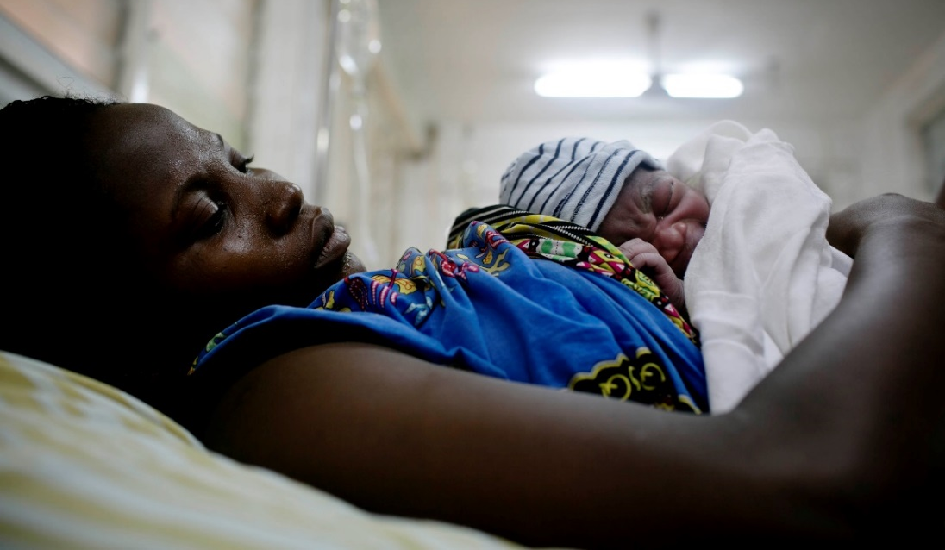
Goal of MDSR (WHO, 2013)
To eliminate preventable maternal mortality
The primary goal of MDSR is to eliminate preventable maternal mortality by obtaining and using information on each maternal death to guide public health actions and monitor their impact.
Notes:
1. WHO, 2013, Maternal death surveillance and response: technical guidance information for action to prevent maternal death. World Health Organization 2013
The Maternal and Child Survival Program (MCSP)Follow
GHANA 2016
PHOTO CREDIT: Kate Holt for JHPIEGO/MCSP.
Mavis Quao, who is 35 years old and already has six children, delivers her baby in the Eastern Regional Hospital, in Accra, Ghana on the 11th January, 2016. Mavis has never been offered family planning before but says that after this birth she is going to. The hospital records 450 deliveries per month. Challenges include lack of appropriate delivery beds, lack of cubicles to handle women at various stages of labor. Though delivery is free, clients pay for normal deliveries to cover up delays in NHIS reimbursement

Slide 27
Overall objectives (WHO, 2013)
To provide information that effectively guides actions to eliminate preventable maternal mortality at health facilities and in the community
To count every maternal death, permitting an assessment of the true magnitude of maternal mortality and the impact of actions taken to reduce it
Notes:
1. WHO, 2013, Maternal death surveillance and response: technical guidance information for action to prevent maternal death. World Health Organization 2013

Slide 28
“No Name, No Blame” Approach to MPDSR
Healthcare providers are vulnerable to blame, which does not improve care
Confidentiality and a “culture of learning and improvement” are essential for a
well-functioning MPDPSR system
“No blame” is NOT “no accountability”
Notes:
WHO, 2013, Maternal death surveillance and response: technical guidance information for action to prevent maternal death. World Health Organization 2013

Slide 29
Reflection
Reflect on a time that you provided care for a woman who died while pregnant or soon after giving birth. Recall the causes and complications that led to her death.

Slide 30
Exercise – Roses & Thorns
Roses – one strength / success using the XX colored sticky note
Thorns – one challenge / missed opportunity using the XX colored sticky note
Place your sticky notes on the flip charts
Notes:
Note to facilitator: Modify the PPT by indicating which color sticky to use for the roses and which to use for the thorns

Slide 31
The Three Delays Model
Widely used framework for examining
care-seeking, decision-making, and quality
of care
It can help identify common delays in:
  seeking care,
  reaching care, and
  receiving care at the facility
Notes:
1. WHO, 2013, Maternal death surveillance and response: technical guidance information for action to prevent maternal death. World Health Organization 2013

Slide 32
The Three Delays Model
Delay 1:
Recognition and decision to seek care
Delay 2:
Transport to care
Delay 3: Receiving quality care
Delays 1 & 2 can lead to a women never reaching a facility or arriving in critical condition. Delays within a facility also contribute to maternal deaths
Length of time from onset of a complication to decision to seek care
Once decision to seek care is made, there can be delays in reaching it

Slide 33
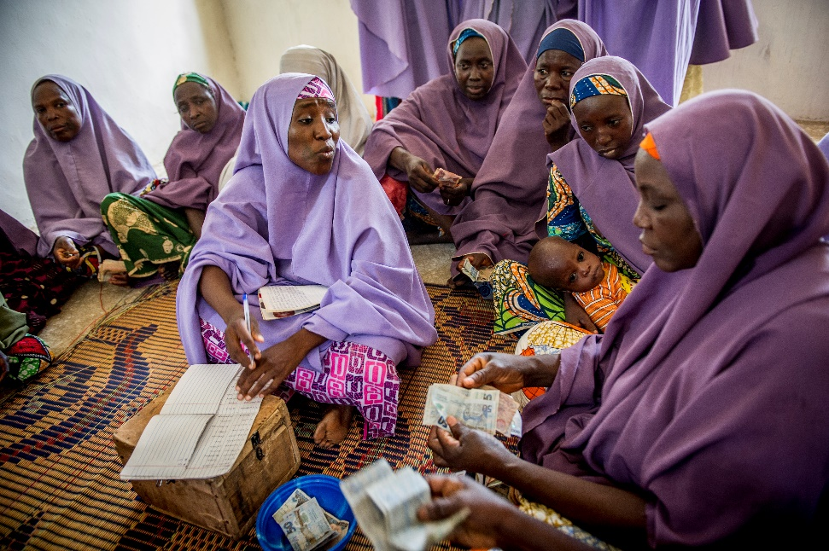
First Delay
Failure to recognize danger signs
Lack of money to pay for medical expenses/transport
Fear of ill-treatment at health facility
Reluctance of the mother or the family to seek care because of cultural constraints
Notes:
(Karen Kasmauski/MCSP). Mada Saving Club for women, over 5500 women belong. Every week, women give money and when they need it, they can borrow with a small interest not payable until after the first month.
This a highly organized organization that has been successful in jump staring women in whatever small busies they want to start. Women give money to the fund every week, they can borrow for projects and pay back with minimum interest.

Slide 34
First Delay, cont’d
Lack of decision-making power
Lack of encouragement from relatives and community members to seek care
Unavailability of someone else to take care of the children, the home, or livestock
Lack of accompaniment to health facility

Slide 35

Second Delay
Distance from a woman’s home to a care facility or provider
Lack of roads or poor condition of roads
Lack of emergency transportation, whether by land or water
Notes:
(

Slide 36
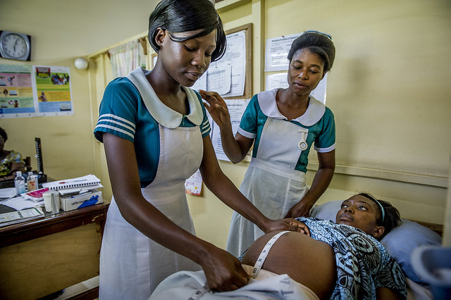
Third Delay
Lack of health-care personnel
Shortages of supplies such as emergency medicines or blood
Lack of equipment for EmONC
Lack of competence of healthcare providers to deliver EmONC
Weak referral system
Gender insensitivity of healthcare providers
Notes:
(Karen Kasmauski/MCSP). MCHIP and USAID underwrite the HoHoe Midwifery Training school in Hohoe. The students get their practical experience at the Municipal Hospital which is connected.
Midwifery students in the labor room observing and participating in the birth process. At the district hospital, Anani Emefa,rt, preceptor is going over the steps of examining a pregnant woman, Comfort Borbor, with student Mavis Abua Anyomi (reading from the book in the beginning and wearing a hat)

Slide 37
Strategies to reducing these 3 delays
Notes:
Source: Lawn, J. E., Lee, A. C., Kinney, M., Sibley, L., Carlo, W. A., Paul, V. K., ... & Darmstadt, G. L. (2009). Two million intrapartum‐related stillbirths and neonatal deaths: where, why, and what can be done?. International Journal of Gynecology & Obstetrics, 107(Supplement), S5-S19.

Slide 38
Discussion
Question and answer with learners
Notes:
Reference: WHO, 2012. The WHO application of ICD-10 to deaths during pregnancy, childbirth and puerperium: ICD MM. World Health Organization 2012
.

Slide 39
Day 1, Session 5
Identifying Maternal Deaths
MDSR Skills-Building Workshop
Notes:
PROThe Maternal and Child Survival Program (MCSP)Follow
2018_02_06_Federal Medical A_102
Nigeria: Lokoja's Federal Medical Center
Mother Blessing Oji, 27, is in labor with her third child. She is being attended to by Mercy Feate, in white; Cecilia, in green.
During her labor, Blessing received support and prayers from members of her church community out loud over the phone.
Photo: Karen Kasmauski/MCSP

Slide 40
Session Objectives
Distinguish between deaths that are maternal deaths and those that are not maternal deaths
Differentiate between direct causes and indirect causes of maternal death
Describe the process of identifying maternal deaths in their facilities

Slide 41
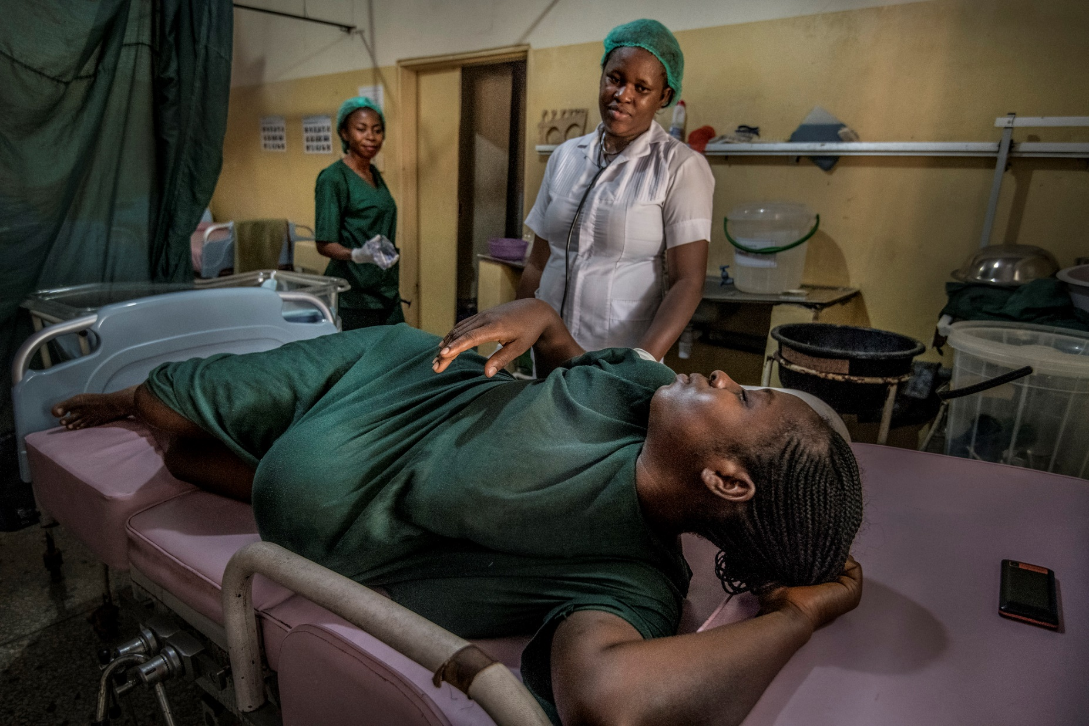
Review Key Definitions
Death during pregnancy, childbirth, and puerperium
Maternal death
Direct obstetric death
Indirect obstetric death
Late maternal death
Notes:
Reference: WHO, 2012. The WHO application of ICD-10 to deaths during pregnancy, childbirth and puerperium: ICD MM. World Health Organization 2012
PROThe Maternal and Child Survival Program (MCSP)Follow
2018_02_06_Federal Medical A_102
Nigeria: Lokoja's Federal Medical Center
Mother Blessing Oji, 27, is in labor with her third child. She is being attended to by Mercy Feate, in white; Cecilia, in green.
During her labor, Blessing received support and prayers from members of her church community out loud over the phone.
Photo: Karen Kasmauski/MCSP
.

Slide 42
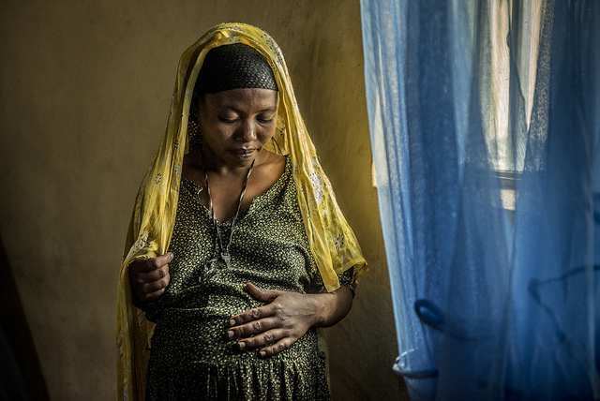
Definition: Death during Pregnancy, Childbirth, and Puerperium
“All deaths of women during or within 42 days of pregnancy regardless
of cause” (ICD-10).
Notes:
This term is useful for two main reasons:
-Cause of death can be difficult to determine.
-In developing countries, a high percentage of deaths that occur during pregnancy and the postpartum period are due to the pregnancy and its complications.
The Maternal and Child Survival Program (MCSP)Follow
2017_06_15_Guba_0202
The Guba Health Center, Halaba Special District in the Southern Nations Nationality People’s Region (SNNPR) serves 41,000 people, and on average, Photo Credit: Karen Kasmauski/MCSP

Slide 43
Definition: Maternal Death
“The death of a woman while pregnant or within 42 days of the termination of pregnancy, irrespective of the duration and site of the pregnancy, from any cause related to or aggravated by the pregnancy or its management but not from accidental or incidental causes.”
Notes:
1. WHO, 2013, Maternal death surveillance and response: technical guidance information for action to prevent maternal death. World Health Organization 2013

Slide 44
Definition: Direct Obstetric Deaths
“Maternal deaths resulting from obstetric complications of the pregnancy state (pregnancy, labour, or puerperium); from interventions, omissions, or incorrect treatment; or from a chain of events resulting from any of the above.”

Slide 45
Definition: Indirect Obstetric Deaths
“Maternal deaths resulting from previously existing disease or disease that developed during pregnancy. These deaths are not due to direct obstetric causes, but are aggravated by the physiological effects of pregnancy.”

Slide 46
Definition: Late Maternal Death
“The death of a woman from direct or indirect causes more than 42 days but less than one year after termination of pregnancy.”

Slide 47
Exercise: Identifying Maternal Deaths
Page 13 of the Learners’ Guide
Identify whether deaths are maternal
If deaths are maternal, are they:
  Direct
  Indirect
  Coincidental

Slide 48
Exercise: Mix & Match
Working in pairs, place your index / meta card on the correct flip chart
Is the cause of death:
  Direct
  Indirect
  Coincidental
  Unknown / Undetermined

Slide 49
Discussion
Question and answer with learners
Notes:
Reference: WHO, 2012. The WHO application of ICD-10 to deaths during pregnancy, childbirth and puerperium: ICD MM. World Health Organization 2012
.

Slide 50
Day 1, Session 6
Day One Wrap-up Discussion
MDSR Skills-Building Workshop

Slide 51
Session Objectives
Review content discussed over the last
5 sessions

Slide 52
Discussion
Review the individual learning plan
Revisit parking lot
Question and answer with learners
Assignment for Day 2
  Review the ICD-MM reference aid and form
  (Pages 37–38 of Learner’s Guide)
  Bring real case summaries or case notes to review
  Review the M/PDSR national guidelines
Notes:
Reference: WHO, 2012. The WHO application of ICD-10 to deaths during pregnancy, childbirth and puerperium: ICD MM. World Health Organization 2012
.

Slide 53
MDSR Capacity-Building Workshop
Day 2

Slide 54
Day 2, Session 1
Day 1 Review and Knowledge Check
MDSR Skills-Building Workshop

Slide 55
Session Objectives
Describe the goals of continual MDSR process
Describe the six steps of the mortality audit cycle
Distinguish between deaths that are maternal deaths and those that are not
Differentiate between direct causes and indirect causes of maternal death

Slide 56
Knowledge Check – Kahoot!
In teams, play the online game
If no internet is available, unhide and continue with slides 4–25 below…
Award 10 points to the first team to answer a question correctly

Slide 57
Question 1
What does MDSR stand for?
  Maternal Death System and Response
  Maternal Death Surveillance and Response
  Maternal Death Surveillance and Review
  Maternal Death Systematic Register

Slide 58
Question 1: Answer
What does MDSR stand for?
  Maternal Death System and Response
  Maternal Death Surveillance and Response
  Maternal Death Surveillance and Review
  Maternal Death Systematic Register

Slide 59
Question 2
Which step in the MDSR process is often not carried out?
  Identification of the death
  Review of the cases
  Ongoing monitoring of recommendations
  Analysis of the contributing factors

Slide 60
Question 2: Answer
Which step in the MDSR process is often not carried out?
  Identification of the death
  Review of the cases
  Ongoing monitoring of recommendations
  Analysis of the contributing factors

Slide 61
Question 3
Which of the following is not part of the MDSR response?
  Action-oriented review mechanisms
  Legal framework for protection of families and providers
  Legal framework for punishing the providers
  Active civil society engagement

Slide 62
Question 3: Answer
Which of the following is not part of the MDSR response?
  Action-oriented review mechanisms
  Legal framework for protection of families and providers
  Legal framework for punishing the providers
  Active civil society engagement

Slide 63
Question 4
Which of these is a maternal death and requires notification?
  36-year-old pregnant woman who died of pneumonia
  52-year-old woman who died in an accident
  24-year-old woman who died in her sleep
  60-year-old woman who died of cancer

Slide 64
Question 4: Answer
Which of these is a maternal death and requires notification?
  36-year-old pregnant woman who died of pneumonia
  52-year-old woman who died in an accident
  24-year-old woman who died in her sleep
  60-year-old woman who died of cancer

Slide 65
Question 5
This term defines all deaths of women during or within 42 days of pregnancy regardless of cause
  Indirect obstetric death
  Maternal death
  Direct obstetric death
  Death during Pregnancy, Childbirth, and Puerperium

Slide 66
Question 5: Answer
This term defines all deaths of women during or within 42 days of pregnancy regardless of cause
  Indirect obstetric death
  Maternal death
  Direct obstetric death
  Death during Pregnancy, Childbirth, and Puerperium

Slide 67
Question 6
This term defines maternal deaths resulting from obstetric complications of the pregnancy state
  Indirect obstetric deaths
  Late maternal deaths
  Direct obstetric deaths
  Maternal deaths

Slide 68
Question 6: Answer
This term defines maternal deaths resulting from obstetric complications of the pregnancy state
  Indirect obstetric deaths
  Late maternal deaths
  Direct obstetric deaths
  Maternal deaths

Slide 69
Question 7
Facility deaths should be identified and notified to the authorities within 24 hours (T/F)
  True
  False

Slide 70
Question 7: Answer
Facility deaths should be identified and notified to the authorities within 24 hours (T/F)
  True
  False

Slide 71
Question 8
Community deaths should be identified and notified to the authorities within 72 hours (T/F)
  True
  False

Slide 72
Question 8: Answer
Community deaths should be identified and notified to the authorities within 72 hours (T/F)
  True
  False

Slide 73
Question 9
Notifying suspected maternal deaths, whether or not any occurred is called ______________
  Review
  Identification
  Complete reporting
  Zero reporting

Slide 74
Question 9: Answer
Notifying suspected maternal deaths, whether or not any occurred is called ______________
  Review
  Identification
  Complete reporting
  Zero reporting

Slide 75
Question 10
________ is the action portion of surveillance
  Response
  Review
  Reaction
  Result

Slide 76
Question 10: Answer
________ is the action portion of surveillance
  Response
  Review
  Reaction
  Result

Slide 77
Question 11
“No name, no game” is a key principle of MDSR (T/F)
  True
  False

Slide 78
Question 11: Answer
“No name, no game” is a key principle of MDSR (T/F)
  True
  False

Slide 79
Discussion
Question and answer with learners
Notes:
Reference: WHO, 2012. The WHO application of ICD-10 to deaths during pregnancy, childbirth and puerperium: ICD MM. World Health Organization 2012
.

Slide 80
Day 2, Session 2
Creating or Strengthening MPDSR Committees
MDSR Skills-Building Workshop

Slide 81
Session Objectives
Create a facility or district/subnational MPDSR committee
Strengthen a facility or district/subnational MPDSR committee to optimize MPDSR processes

Slide 82
Illustrative National MPDSR Structure
National
District
Facility
Provincial
Notes:
Note to facilitator – if needed, please re-label boxes to reflect your government structure (e.g. Provincial or State or Governorate or Union, etc.)

Slide 83
Principles of MPDSR Committee Membership
National guidelines often define MPDSR committee membership
Ideally, members should include a broad range of staff who have a role in maternal care
This may include: doctors, midwives, nurses, auxiliary nurses, social workers, managers, lab technicians, pharmacists, ambulance drivers/staff, surgical team (anaesthetists, surgical nurses and technicians), and others

Slide 84
Review and Discussion: MPDSR Structures & Membership
Please turn to page XX in the national MPDSR guidelines
Read the section that defines the structures and membership of facility and district/subnational MPDSR committees
Are these guidelines clear?
Does the membership of your local MPDSR committee align with national and/or global guidelines?
Notes:
Note to facilitator – please update the slide to include the correct page number in your national guidelines. If there are no instructions for membership, lead the group in a discussion of structure and potential members of an MPDSR committee within their facility/district.

Slide 85
Ensuring a “No Name” Environment
“No Name” = Protecting confidentiality of client and providers
Ensure that patient and provider names are not visible on any of the materials reviewed by the MPDSR committee (patient medical record, MPDSR summary form, etc.)
Ensure that patient and provider names are not shared or discussed during the committee meetings

Slide 86
Ensuring a “No Blame” Environment
“No Blame” = Promoting a constructive, non-punitive response to maternal deaths
Emphasize learning, information gathering, and prevention (instead of blaming or punishment of providers)
Develop a Code of Conduct that encourages problem solving rather than punishment or blame
Create and sign non-disclosure pledges
Acknowledge that mistakes happen, and the purpose of the MPDSR committee is to learn, and to prevent future mortality
Notes:
Note to facilitator – If you are aware of any, please provide examples of how creating a “no blame environment” has lead to improvements in quality of care. Examples can be from any country or setting.

Slide 87
Preparing for an MPDSR Meeting
Select members of the MPDSR committee
Clarify committee member responsible for collecting reference materials
Collect reference materials (e.g. clinical protocols, standards, manuals)
Ensure that all members are aware of the “No name, no blame” principle
Identify deaths for review
Prepare a file for each death to be reviewed (with anonymized patient records and registers, if available)
Develop the case summary for each death (should not include names of patient or provider)
Schedule the review meeting
Notes:
4 – Death File – should include anonymized patient record (if available), ANC card, relevant registers where the woman’s information is recorded, notes from any interviews with facility or community level sources

Slide 88
Maternal Death Review Process
MPDSR focal person will identify and notify probable maternal deaths immediately within 24–48 hours
Facility maternal deaths should be discussed by facility MPDSR committee within XX days
The focal person will prepare and present a narrative clinical summary using provided guidance
Notes:
Note to facilitator: Please update text in red according to specifications within national guidelines
The review of maternal/perinatal deaths is an important step in MPDSR because each maternal/perinatal death has a story that we can learn from

Slide 89
Maternal Death Review Process: Steps
Preparation – Invitation, venue, norms, clinical summary
Review of the recommendations from the previous meeting
Present the clinical summary
Conduct the review focusing on understanding the chain of events from prior to admission, admission and death
Notes:
The review of maternal/perinatal deaths is an important step in MPDSR because each maternal/perinatal death has a story that we can learn from

Slide 90
Maternal Death Review Process: Steps
Develop response plan
Complete the maternal and perinatal reviews report forms
Plan for the next committee meeting

Slide 91
Exercise: Creating or Strengthening MPDSR Committees
Break into 4 small groups
Review the “Illustrative roles and responsibilities for an MPDSR committee” on Page 18 of the Learner’s Guide
Assign roles to members of your small groups
Discuss how your committee will promote a
“No name, No blame” environment
Notes:
Note to facilitator: Please update the number of groups based on the number of available participants

Slide 92
Discussion
How will you ensure that your MPDSR
(or MPDSR/QI) committee maintains a
“No name, No blame” environment?
Would you suggest any changes to the membership of your local MPDSR
(or MPDSR/QI) committee?

Slide 93
Day 2, Session 3
Introduction to MDSR Forms
MDSR Skills-Building Workshop

Slide 94

Session Objectives
Identify the key components of country-specific MDSR forms
Describe the sample MDSR forms that will be used in the workshop to build core MDSR skills
Demonstrate how to complete a case summary of a maternal death using a sample MDSR form
Notes:
The Maternal and Child Survival Program (MCSP)Follow
2018_02_15_Student Nursing_037
Nigeria: Abakaliki town in Ebonyi State, at Ebonyi State University Department of Nursing where the students work with instructors, demonstrate breastfeeding, birthing the placenta and injecting birth control.
Student nurses head to class. This university is an important pre-service education institution for Nigeria's next generation of nurses.
Photo: Karen Kasmauski/MCSP

Slide 95
Maternal Death Review Form
Captures relevant information to record the events leading to the maternal death
Information should be recorded anonymously
Notes:
Source: De Brouwere V., Zinnen V., Delvaux T. (2013) How to conduct Maternal Death Reviews (MDR). Guidelines and tools for health professionals. London, International Federation of Gynecologists and Obstetricians, FIGO LOGIC

Slide 96
Sources of Information for Maternal Death Review Form
Ward and operating theatre registers
Antenatal cards
Inpatient medical records and files
Emergency department records
Admission and discharge registers
Interviewing staff involved in the patient’s care and other relevant people involved
Interviewing other people in the community
Notes:
De Brouwere V., Zinnen V., Delvaux T. (2013) How to conduct Maternal Death Reviews (MDR). Guidelines and tools for health professionals. London, International Federation of Gynecologists and Obstetricians, FIGO LOGIC

Slide 97
Key Components of Maternal Death
Review Form
Anonymized personal details: age, marital status, occupation, etc.
Information about:
  Delivery
  Referral (to capture First and Second Delay)
  Management on admission (to capture Third Delay)
  Any complications
Detailed case summary
Notes:
De Brouwere V., Zinnen V., Delvaux T. (2013) How to conduct Maternal Death Reviews (MDR). Guidelines and tools for health professionals. London, International Federation of Gynecologists and Obstetricians, FIGO LOGIC

Slide 98
Case Summary
The case summary should present facts without expressing any judgment on the appropriateness of actions undertaken
It summarizes the case history in narrative form
The summary should be comprehensive, precise, and concise
Notes:
De Brouwere V., Zinnen V., Delvaux T. (2013) How to conduct Maternal Death Reviews (MDR). Guidelines and tools for health professionals. London, International Federation of Gynecologists and Obstetricians, FIGO LOGIC

Slide 99
Key Components of the Case Summary
Patient background
ANC history
Labor and delivery details
Cause of death:
  events leading to the death
  contributing factors
Notes:
Facilitator:
Examples of patient background: age, race/ethnicity, gravidity/parity, gestational age at time of presentation/death, pregnancy outcome (undelivered, still birth, live birth)
Examples from history of ANC include : week/month of first ANC, how many visits, type of facility, type of care provider, distance from place of residents
Delivery: date and time, day of the week, place of delivery, type of place, type of delivery attendant, type of delivery (vaginal, assisted, caesarean section)

Slide 100
Sample MDSR Forms Used in Workshop
Maternal Death Review and Clinical Summary Forms (D2/S3)
MDSR Form: Modifiable Factors (D3/S2)
MDSR Form: Priority responses to implement and monitor (D3/S2)
Aggregate MDSR Form: Common Modifiable Factors and Aggregated Priority Responses to Accelerate Reduction of Maternal Deaths (D3/S3)

Slide 101
Discussion
Case Scenario A: Example
Page 21 of Learners Guide
Read Scenario A
Discuss the proposed case summary: Is there anything you would change?

Slide 102
Exercise: Case Summary
Break into small groups
Each group reviews one Maternal Death Review and Clinical Summary Form Scenario (1 through 4)
In small groups, review your assigned scenario and complete a case summary

Slide 103
Exercise: Facility-level Case Summaries
Remain in small groups
Review completed country-specific
facility-level case summary
Share observations comparing real case summary with the case summary from scenarios in the previous activity

Slide 104
Discussion
Question and answer with learners
Notes:
Reference: WHO, 2012. The WHO application of ICD-10 to deaths during pregnancy, childbirth and puerperium: ICD MM. World Health Organization 2012
.

Slide 105
Day 2, Session 4
Cause Assignment Using the ICD-MM
MDSR Skills-Building Workshop

Slide 106

Session Objectives
Correctly assign the causes of maternal deaths using the
ICD-MM classification system
Nurse at Nigeria’s Lokoja Federal Medical Center
Notes:
The Maternal and Child Survival Program (MCSP)Follow
2018_02_06_Federal Medical_469
Nigeria: Lokoja's Federal Medical Center
Blessing Oji, 27 (not pictured), is in labor with her third child.
Here, midwife Cecilia Nadi checks in with Blessing during labor.
Photo: Karen Kasmauski/MCSP

Slide 107
ICD-10: Definition
International statistical classification of diseases and related health problems, tenth revision (ICD-10) is the standard tool to guide the collection, coding, tabulation and reporting of mortality statistics based on civil registration. (WHO 2012)
Notes:
WHO 2012, The WHO application of ICD-10 to deaths during pregnancy, childbirth and puerperium: ICD M, World Health Organization 2012

Slide 108
ICD: Maternal Mortality
ICD-MM is the application of the coding rules of the ICD-10 to deaths during pregnancy, childbirth, and the puerperium.
Notes:
WHO 2012, The WHO application of ICD-10 to deaths during pregnancy, childbirth and puerperium: ICD M, World Health Organization 2012
What is ICD-MM
ICD-Maternal Mortality (ICD-MM) is the application of the coding rules of the 10th revision of the ICD (ICD-10) to deaths during pregnancy, childbirth, and the puerperium.
It is intended to facilitate the consistent collection, analysis and interpretation of information on maternal deaths.

Slide 109
Uses of the ICD-MM
For use by health-care providers and those who complete death certification
Standardizes the identification of direct and indirect causes of maternal death
Notes:
The Maternal and Child Survival Program (MCSP)Follow
2018_02_08_Okene A_301
Nigeria: Okene Zonal Hospital
A health attendant (wearing blue) is preparing a C-section kit for Adul Rasheed Rabat (wearing green on the bed) who has chosen to have a planned C-section.
Photo: Karen Kasmauski/MCSP

Slide 110
Why Standardize Causes of Death?
To improve:
interpretation of data on maternal mortality
analysis on the causes of maternal death
allocation of resources and programmes intended to address maternal mortality

Slide 111
Cause Assignment
Group 1: Pregnancy with abortive complication
Group 2: Hypertensive disorders of pregnancy
Group 3: Obstetric Haemorrhage
Group 4: Pregnancy-related infection
Group 5: Other obstetric complications

Slide 112
Cause Assignment 2
Group 6: Unanticipated complications of management
Group 7: Non-obstetric complications
Group 8: Unknown
Group 9: Coincidental causes (accident)

Slide 113
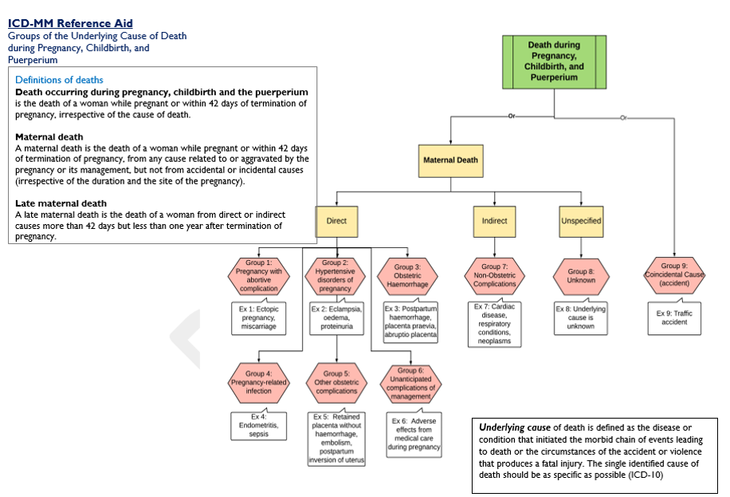
ICD-MM Reference Aid
Refer to Learner’s Guide Page 37

Slide 114
Medical Certificate of Cause of Death (MCCD)
The medical certificate of cause of death (MCCD) is designed to help the certifier record the whole sequence of events leading to death
Death certificates should also include questions about current pregnancy and pregnancy within one year preceding death
Notes:
WHO 2012, The WHO application of ICD-10 to deaths during pregnancy, childbirth and puerperium: ICD M, World Health Organization 2012

Slide 115
Components of MCCD
Part I
Disease or condition leading directly to death
Antecedent causes:
  Due to or as a consequence of b)
  Due to or as a consequence of c)
  Due to or as a consequence of d)
Part II
Other significant conditions contributing to death but not related to the disease or condition causing it

Slide 116
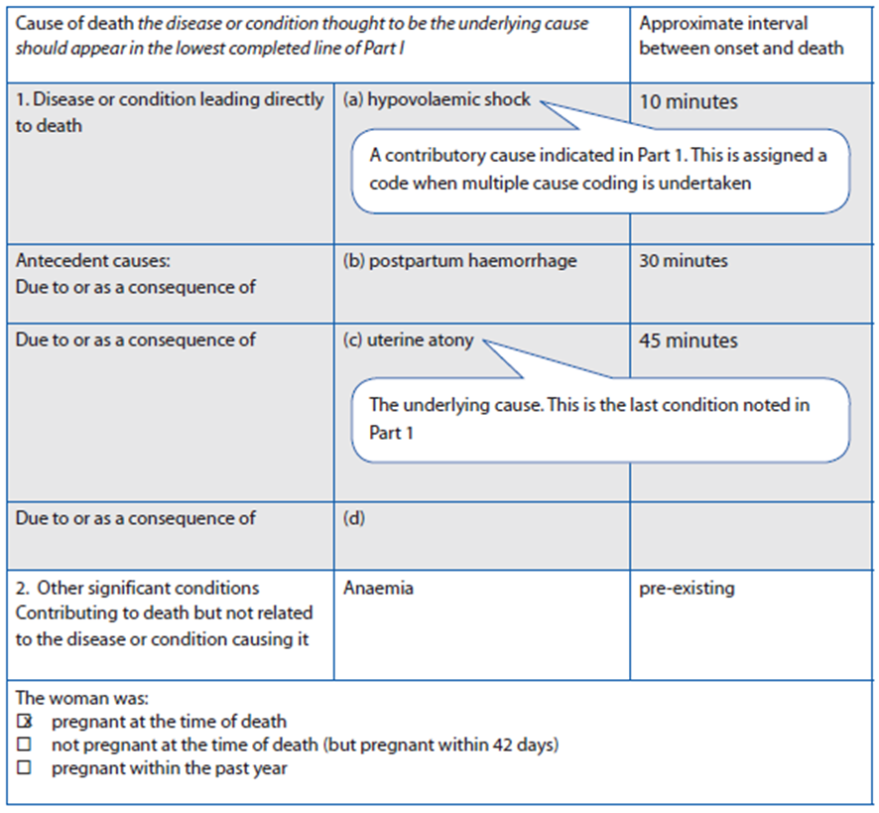
Example 1
A woman who had anaemia during pregnancy and after delivery had a postpartum haemorrhage due to uterine atony, and died as a result of hypovolaemic shock.

Slide 117
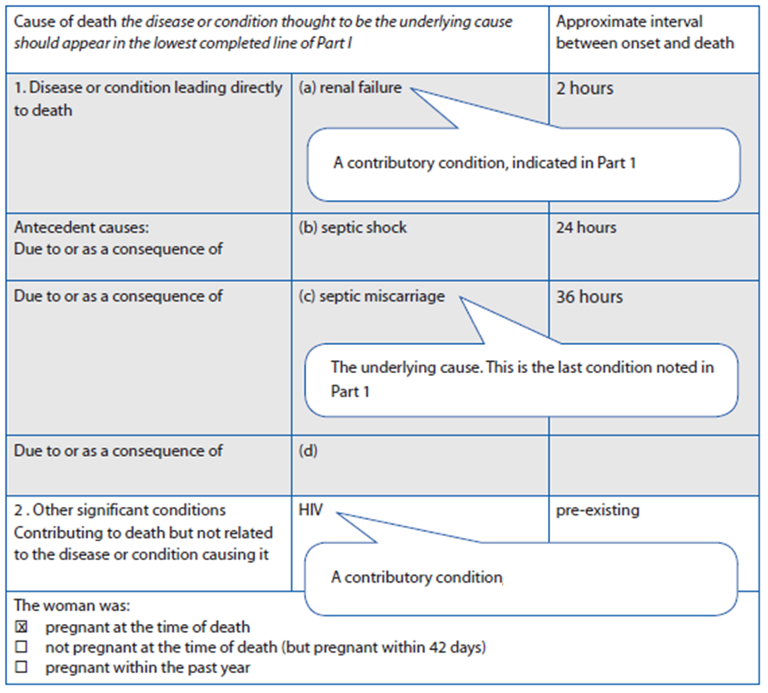
Example 2
A woman infected with HIV who has a spontaneous abortion that becomes infected, and dies due to septic shock and renal failure.

Slide 118
Exercise: Assigning Cause of Death Using the MCCD Form
Group work: return to groups from the last exercise (Scenarios 1–4)
Complete the MCCD form for your scenario
Assign the ICD-MM group for your scenario

Slide 119
MCCD Example: Abortion
Cause of death (The disease or condition thought to be the underlying cause should appear in the lowest completed line of part I) |  | Approximate interval between onset and death
Part I Disease or condition leading directly to death | a) Septic shock | 5 hours
Antecedent causes: Due to or as a consequence of | b) Septicemia | 24 hours
Due to or as a consequence of | c) Septic incomplete abortion | 72 hours
Due to or as a consequence of | d)
Part II Other significant conditions Contributing to death but not related to the disease or condition causing it
The woman was: X pregnant at the time of death □ not pregnant at the time of death (but pregnant within 42 days) □ pregnant within the past year

Slide 120
MCCD Example
Scenario 1: PPH
Cause of death (The disease or condition thought to be the underlying cause should appear in the lowest completed line of part I) |  | Approximate interval between onset and death
Part I Disease or condition leading directly to death | a) Hypovolemic shock | 3 hours
Antecedent causes: Due to or as a consequence of | b) Postpartum haemorrhage | 5 hours
Due to or as a consequence of | c) Uterine Atony | 6 hours
Due to or as a consequence of | d)
Part II Other significant conditions Contributing to death but not related to the disease or condition causing it
The woman was: X pregnant at the time of death □ not pregnant at the time of death (but pregnant within 42 days) □ pregnant within the past year

Slide 121
MCCD Example
Scenario 2: Uterine Rupture
Cause of death (The disease or condition thought to be the underlying cause should appear in the lowest completed line of part I) |  | Approximate interval between onset and death
Part I Disease or condition leading directly to death | a) Hypovolemic shock | 1 hour
Antecedent causes: Due to or as a consequence of | b) Obstetric haemorrhage | 3 hours
Due to or as a consequence of | c) Uterine rupture | 5 hours
Due to or as a consequence of | d)
Part II Other significant conditions Contributing to death but not related to the disease or condition causing it
The woman was: X pregnant at the time of death □ not pregnant at the time of death (but pregnant within 42 days) □ pregnant within the past year

Slide 122
MCCD Example
Scenario 3: PEE
Cause of death (The disease or condition thought to be the underlying cause should appear in the lowest completed line of part I) |  | Approximate interval between onset and death
Part I Disease or condition leading directly to death | a) Cerebrovascular haemorrhage/Stroke | 16 hours
Antecedent causes: Due to or as a consequence of | b) High blood pressure | 36 hours
Due to or as a consequence of | c) Pre-eclampsia/Eclampsia
Due to or as a consequence of | d)
Part II Other significant conditions Contributing to death but not related to the disease or condition causing it
The woman was: X pregnant at the time of death □ not pregnant at the time of death (but pregnant within 42 days) □ pregnant within the past year

Slide 123
MCCD Example
Scenario 4: Anesthesia
Cause of death (The disease or condition thought to be the underlying cause should appear in the lowest completed line of part I) |  | Approximate interval between onset and death
Part I Disease or condition leading directly to death | a) Brain damage/Hypoxia | 1 hour
Antecedent causes: Due to or as a consequence of | b) Complications of anaesthesia | 3 hours
Due to or as a consequence of | c)
Due to or as a consequence of | d)
Part II Other significant conditions Contributing to death but not related to the disease or condition causing it
The woman was: □ pregnant at the time of death X not pregnant at the time of death (but pregnant within 42 days) □ pregnant within the past year

Slide 124
Discussion
Question and answer with learners
Notes:
Reference: WHO, 2012. The WHO application of ICD-10 to deaths during pregnancy, childbirth and puerperium: ICD MM. World Health Organization 2012
.

Slide 125
Day 2, Session 5
Day Two Wrap-up and Discussion
MDSR Skills-Building Workshop

Slide 126

Session Objective
Review content discussed over the last 4 sessions
Karen Kasmauski/MCSP
Notes:
The Maternal and Child Survival Program (MCSP)Follow
2014_06_18_Hohoe Midwifery_0794
(MCHIP and USAID underwrite the HoHoe Midwifery Training school in Hohoe. The students get their practical experience at the Municipal Hospital which is connected.
Students going through skills training, in the labor room and hospital have a chance to work with women in labor as well as the delivery and care of newborns.
Newly born baby girl.

Slide 127
Discussion
Revisit parking lot
Q & A: Any outstanding questions or comments?
Assignment for Day 3
  Please review the following items in the Learner’s Guide:
    MDSR Individual Death Review Response Plan (pg. 47–48)
    Data exercises located in Day 3, Session 3 (pg. 50–56)
  Complete the HMIS Data Availability Review Form
  (pg. 57–58)

Slide 128
MDSR Capacity-Building Workshop
Day 3

Slide 129
Day 3, Session 1
Day Two Review
MDSR Skills-Building Workshop

Slide 130
Session Objectives
Review content learned in the previous days
Review the ICD-MM reference aid

Slide 131
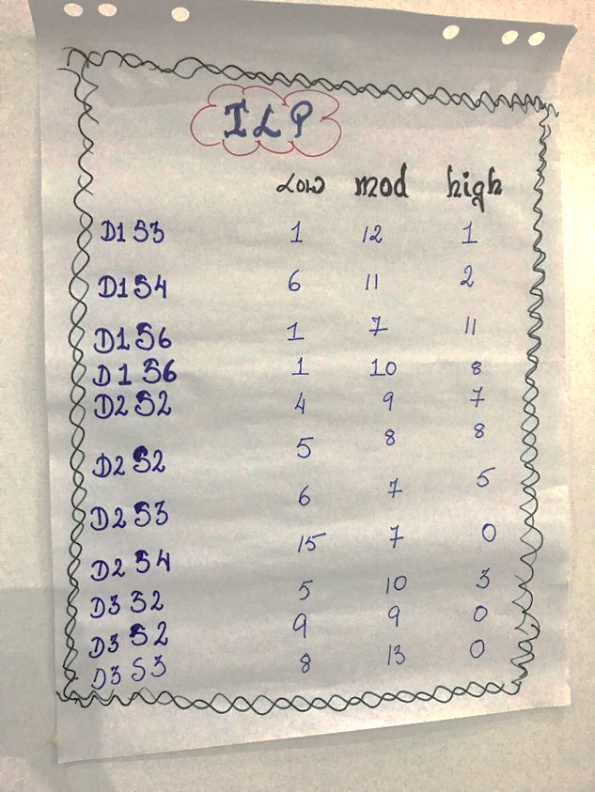
Revisiting the Individual Learning Plans
Notes:
Facilitator: Feel free to update the picture with the ILP tally sheet from the current workshop

Slide 132
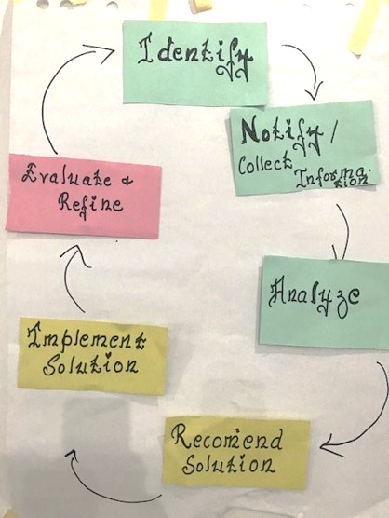
Revisiting the 6 Steps of the Audit Cycle
Focus of Day 3:
Recommend Solutions
Implement Solutions
Evaluate and Refine
Notes:
Facilitator: Feel free to update the picture with correct picture of the six step audit cycle completed during the current workshop

Slide 133
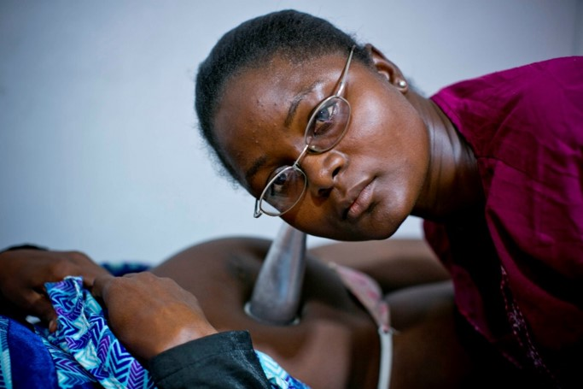
Jeopardy Game
Break into 2 teams
The team with the most points wins!
Notes:
The Maternal and Child Survival Program (MCSP)Follow
LIBERIA 2016
Photo Credit: Kate Holt for Jhpiego/MCSP.
Wed. Jan 6th, 2016.
A midwife examines a patient in a private health clinic in Monrovia, Liberia . Jhpiego has been supporting both private and government clinics during the recent Ebola outbreak by providing Infection Prevention Control (IPC) training to all health workers.

Slide 134
HOME
1 | 4 | 3
5 | 9 | 6
2 | 8 | 7

Slide 135
1 point
A woman was 3 months pregnant, had severe bleeding and died after reaching the hospital.
  Group 1
  Group 2
  Group 3

Slide 136
1 point
A woman was 3 months pregnant, had severe bleeding and died after reaching the hospital.
  Group 1 – Pregnancy with abortive complication
  Group 2
  Group 3

Slide 137
2 points
A woman gave birth at home 2 weeks ago. She arrived at the hospital complaining of severe abdominal pain, high fever and a foul vaginal discharge. Her symptoms began 2 days after giving birth. She received antibiotics but she died.
  Group 4
  Group 5
  Group 7

Slide 138
2 points
A woman gave birth at home 2 weeks ago. She arrived at the hospital complaining of severe abdominal pain, high fever and a foul vaginal discharge. Her symptoms began 2 days after giving birth. She received antibiotics but she died.
  Group 4 – Pregnancy-related infection
  Group 5
  Group 7

Slide 139
3 points
A woman delivered at the health facility and was sent home after two hours. However, she developed severe bleeding at home and was rushed to the hospital but died.
  Group 1
  Group 3
  Group 7

Slide 140
3 points
A woman delivered at the health facility and was sent home after two hours. However, she developed severe bleeding at home and was rushed to the hospital but died.
  Group 1
  Group 3 – Obstetric haemorrhage
  Group 7

Slide 141
4 points
A woman came to the hospital in labour. She reported having had seizures at home. She lost consciousness and died before being treated.
  Group 5
  Group 2
  Group 8

Slide 142
4 points
A woman came to the hospital in labour. She reported having had seizures at home. She lost consciousness and died before being treated.
  Group 5
  Group 2 – Hypertensive disorders of pregnancy
  Group 8

Slide 143
5 points
A pregnant woman was going for her ANC visit when the bus she was travelling on overturned and she died
  Group 5
  Group 6
  Group 9

Slide 144
5 points
A pregnant woman was going for her ANC visit when the bus she was travelling on overturned and she died
  Group 5
  Group 6
  Group 9 – Coincidental cause (accident)

Slide 145
6 points
A woman with obstructed labour was rushed to the theater for emergency caesarean section. She did not wake up from anaesthesia.
  Group 4
  Group 6
  Group 8

Slide 146
6 points
A woman with obstructed labour was rushed to the theater for emergency caesarean section. She did not wake up from anaesthesia.
  Group 4
  Group 6 – Unanticipated complications of management
  Group 8

Slide 147
7 points
A pregnant woman with pre-existing hypertensive heart disease went into labor. After delivery of the placenta, the midwife administered ergometrine to stop the bleeding. The woman collapsed and died in the delivery room.
  Group 7
  Group 8
  Group 9

Slide 148
7 points
A pregnant woman with pre-existing hypertensive heart disease went into labor. After delivery of the placenta, the midwife administered ergometrine to stop the bleeding. The woman collapsed and died in the delivery room.
  Group 7 – Non-obstetric complications
  Group 8
  Group 9

Slide 149
8 points
A woman delivered at home. Her TBA was unable to help her deliver the placenta, and referred her to the hospital. She died in the ambulance on the way to the hospital.
  Group 5
  Group 6
  Group 7

Slide 150
8 points
A woman delivered at home. Her TBA was unable to help her deliver the placenta, and referred her to the hospital. She died in the ambulance on the way to the hospital.
  Group 5 – Other obstetric complications
  Group 6
  Group 7

Slide 151
9 points
A woman who gave birth 3 weeks ago had been teary since the birth of her child and not eating or sleeping well. She was found dead in her bedroom with an empty packet of rat poison next to her bed.
  Group 4
  Group 5
  Group 6

Slide 152
9 points
A woman who gave birth 3 weeks ago had been teary since the birth of her child and not eating or sleeping well. She was found dead in her bedroom with an empty packet of rat poison next to her bed.
  Group 4
  Group 5 – Other obstetric complications
  Group 6

Slide 153
Discussion
Question and answer with learners
Notes:
Reference: WHO, 2012. The WHO application of ICD-10 to deaths during pregnancy, childbirth and puerperium: ICD MM. World Health Organization 2012
.

Slide 154
Day 3, Session 2
Identifying Modifiable Contributing Factors for a Maternal Death and Priority Responses to Implement and Monitor
MDSR Skills-Building Workshop

Slide 155
Session Objectives
Identify modifiable factors that contributed to a maternal death
Describe components of a SMART response based on identified modifiable factors
Develop response plans (facility and district level) for implementing and monitoring based on identified modifiable factors

Slide 156
Guiding Principles for Planning Responses
Start with the avoidable factors identified during the review process
Use evidence-based approaches
Prioritize (based on prevalence, feasibility, costs, resources, health-system readiness, health impact)
Establish a timeline
Decide how to monitor progress, effectiveness, impact
Integrate recommendations within annual health plans and health-system packages
Monitor to ensure that recommendations are being implemented
Notes:
From the WHO 2013 MDSR Technical Guidelines

Slide 157
What are SMART responses?
Specific
Measureable
Achievable
Relevant
Time-bound

Slide 158
What does S – M – A – R – T mean?
Specific: What will you do? Who will do it?
Measureable: How will you demonstrate improvement?
Achievable: Can you complete the action within the time frame given the knowledge, skills, and resources available?
Relevant: Are the proposed actions relevant to the issues that you’ve identified?
Time-bound: By when will you complete these actions?

Slide 159
SMART Example
Increase the number of women receiving a uterotonic immediately following birth by 10% in the next 12 months

Slide 160
The Three Delays Model
Delay 1:
Recognition and decision to seek care
Delay 2:
Transport to care
Delay 3:
Receiving quality care
Delays 1 & 2 can lead to a women never reaching a facility or arriving in critical condition. Delays within a facility also contribute to maternal deaths.
Length of time from onset of a complication to decision to seek care.
Once decision to seek care is made, there can be delays in reaching it.

Slide 161
Response Plan Development
Prioritize the problems identified
Propose recommendations to address the three delays
Identify deadlines and persons responsible
Develop mechanism for implementation
Identify additional resources needed
Include monitoring of implementation

Slide 162
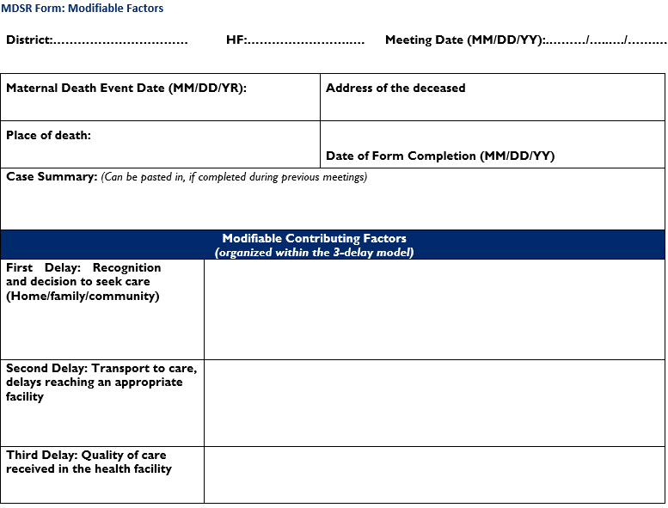
MDSR Individual Death Review Response Plan

Slide 163
MDSR Individual Death Review Response Plan
MDSR Form: Priority responses to implement and monitor
Modifiable Contributing Factors | Response (What to do) | Responsible person (Ensures completion of response) Specify facility and/or district | Target completion date | Follow up Progress Notes (completed/ ongoing/failed)

Slide 164
Exercise – Response Planning
Return to your small groups (scenarios 1–4)
Work on the response plans for your scenarios
Turn to Page 47 in the learner’s guide
Debrief: One group reports back

Slide 165
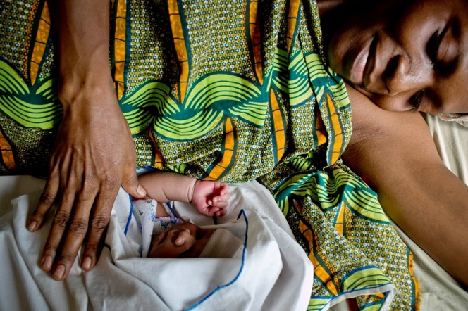
Tracking Response Plan Implementation & Follow Up
Regular review of response plan implementation
Identify responses accomplished
Identify responses not accomplished and reasons
Re-evaluate implementation
Propose further responses with deadlines, persons responsible and mechanism for implementation
Notes:
Include notes about following up on an action plan
The Maternal and Child Survival Program (MCSP)Follow
GHANA 2016
PHOTO CREDIT: Kate Holt for JHPIEGO/MCSP.
Matilda Totame who is 33 years old, watches over her newborn baby in the Ashaiman Polyclinic in Accra, Ghana.

Slide 166
Examples of Strategies for Follow-up
Include review of previous recommendations during each MPDSR committee meeting
Create a sub-committee to track implementation of recommendations and report back at each MPDSR committee meeting
Develop a follow-up schedule with one person assigned to check in regularly with persons responsible for recommendations
Display all recommended responses on a board and have one person responsible for tracking implementation of recommendations

Slide 167
Discussion
Question and answer with learners
Notes:
Reference: WHO, 2012. The WHO application of ICD-10 to deaths during pregnancy, childbirth and puerperium: ICD MM. World Health Organization 2012
.

Slide 168
Day 3, Session 3
Monitoring and Analysing Trends in Causes of Maternal Deaths and Findings of Death Reviews to Prioritize Aggregated Responses
MPDSR Skills-Building Workshop

Slide 169
Session Objectives
Practice monitoring and analysing trends in causes of facility maternal death and findings of death reviews for leading local causes of death
Practice prioritizing aggregated responses at the facility and district/subnational level based on analysis of local trends in causes of maternal death and findings of death reviews
Review availability of maternal death data elements in country HMIS materials (facility and subnational) and discuss ways to strengthen availability of maternal health and death data in HMIS

Slide 170
Why Should MPDSR Committees Examine Trends In Maternal Data And Audit Findings?
Analyzing trends in aggregated data allows MPDSR committees to:
Identify trends in numbers of deaths
Identify trends in causes of death
Examine patterns of modifiable factors which are contributing to leading causes of deaths
Prioritize actions to address common, recurrent and persistent contributing factors

Slide 171
Data Sources & Indicators – Analyzing Trends
MPDSR and Quality Improvement committees may track multiple indicators to measure their progress in improving maternal and perinatal care
Data may be drawn from multiple sources, including client records, facility registers, facility summary HMIS reporting forms, national HMIS data and completed audit (reports?) files from past MPDSR reviews
One key indicator of interest for MPDSR committees is the cause of maternal deaths, to be able to analyze and act on trends in causes of maternal death

Slide 172
Example: Calculating Proportion of Maternal Deaths by Individual Cause
Q: What proportion (%) of maternal deaths at the Central Teaching Hospital were caused by PPH?
A: 50 (Deaths from PPH) ÷ 100 (total deaths) = 50%
EXAMPLE: Central Teaching Hospital - Causes of Maternal Mortality - 2017
Deaths from PPH | 50
Deaths from PE/E | 30
Deaths from Infection | 15
Other | 5
Total Maternal Deaths | 100

Slide 173
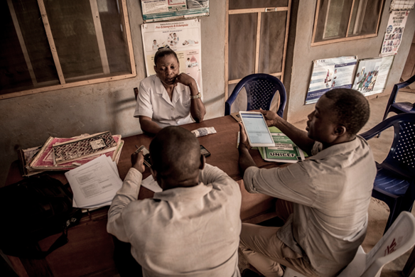
Exercise A – Calculating percent of maternal deaths by cause
Return to small groups
Turn to Page 50 in learner’s guide
Use the data in Table 19 to calculate the percent of deaths by cause for each of 6 months (January – June)

Slide 174
Discussion – Exercise A
What was the leading cause of death at this facility?
What was the second leading cause of death?

Slide 175
Exercise B – Response Plan Review and Analysis
Continue to Page 52 in learners guide
Review the summary of modifiable factors and responses
As a group, discuss the questions on Page 53 for analysing and prioritizing common modifiable factors based on review of several audit findings

Slide 176
Discussion – Exercise B
What were the most important and common modifiable factors identified by your group?
What actions did your MPDSR committee use to prioritize activities to reduce deaths of women due to PPH in your facility?
In your setting, is it possible to review previous audit findings to identify common modifiable factors and responses, as has been done in Table 15?

Slide 177
What is Data Visualization and Why is it Important?
Data visualization is the presentation of quantitative data in visual graphics such as bars, dots or lines
Helps to understand trends and patterns
Makes analysis and understanding of data easier
Shows increases or decreases over time
Example: The Bar Chart
  Commonly used to display health data in facilities
  Can be used to show progress towards a target or goal

Slide 178
Exercise C – Visualizing Trends in the Causes of Maternal Deaths
Continue to Page 56 in the learner’s guide
Use the data in Table 17 to create a bar graph of the monthly proportion of deaths by cause (from July–December)

Slide 179
Discussion – Exercise C
Decline in total number of deaths
Decline in the relative proportion (%) of deaths due to PPH
Increase in % of deaths due to PE/E as % deaths due to PPH decline

Slide 180
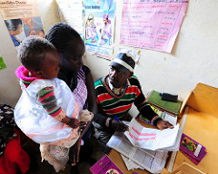
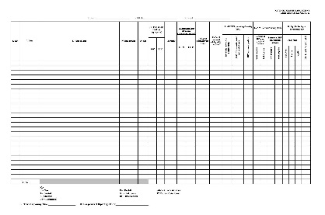
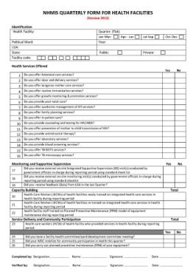
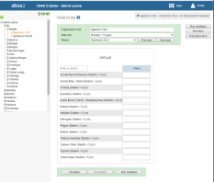

Data Availability and Flow – HMIS Systems
Client-provider interaction (e.g. patient record)
Registers
Summary Forms
DHIS2 or other software
HMIS data flow example: Nigeria
Facility
District
Provincial and National
Notes:
Facilitator: This slide shows a typical flow of data through country HMIS systems. Feel free to update as needed to reflect the data flow in your country

Slide 181
Data Availability within HMIS Systems
Many country HMIS systems lack data elements needed to track causes and frequency of maternal deaths
  Client-level records might not be available, or might not be standardized across facilities
  Many facility-level registers do not include designated data elements (e.g. columns) to record causes of maternal death
  Even when data on cause of maternal death is captured in a facility register it may not be included in the facility’s HMIS summary reporting form and hence may not be included in a country’s national HMIS

Slide 182
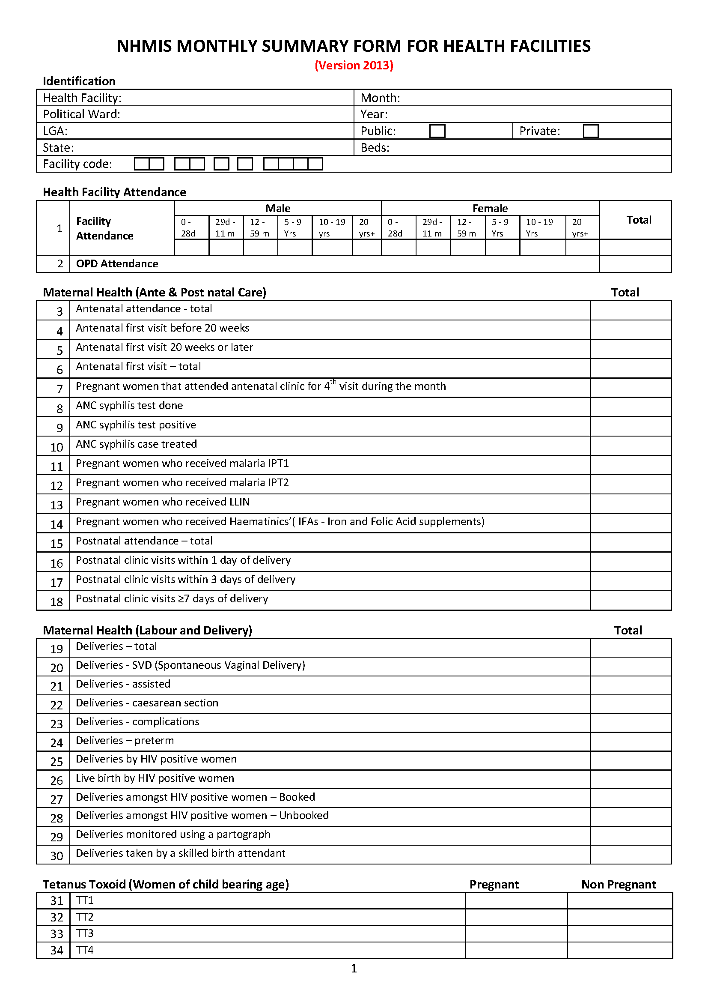
Country Specific HMIS Forms Update with country–specific form
Notes:
Note to facilitator: Updated the forms with country specific HMIS form

Slide 183
Country Name:
Data Availability Review Form
HMIS Form | Patient Record | Hospital Register | Health Center Register | HMIS Monthly Summary Reporting Form
Designated space to record individual/cumulative maternal deaths? | Yes/No | Yes/No | Yes/No | Yes/No
Designated space to record cause of maternal deaths? | Yes/No | Yes/No | Yes/No | Yes/No
If YES, how is data cause of maternal deaths? | Open ended space/ Designated data elements/ Not applicable | Open ended space/ Designated data elements/ Not applicable | Open ended space/ Designated data elements/ Not applicable | Open ended space/ Designated data elements/ Not applicable
Notes:
Note to facilitator :
Replace the text in red (country name) with the name of your country
Answer the questions for your country by circling yes or no and then discuss the findings with the learners.

Slide 184
Country Name:
Data Availability Review Form
HMIS Form | Patient Record | Hospital Register | Health Center Register | HMIS Monthly Summary Reporting Form
Causes of maternal death with designated data elements in each type of form? | PPH; APH; PE/E; Sepsis; Obstructed labour; Abortion complications; Malaria; HIV; Others (specify) Not applicable | PPH; APH; PE/E; Sepsis; Obstructed labour; Abortion complications; Malaria; HIV; Others (specify) Not applicable | PPH; APH; PE/E; Sepsis; Obstructed labour; Abortion complications; Malaria; HIV; Others (specify) Not applicable | PPH; APH; PE/E; Sepsis; Obstructed labour; Abortion complications; Malaria; HIV; Others (specify) Not applicable
Space for deaths audited? | Yes/No | Yes/No | Yes/No | Yes/No
Notes:
Note to facilitator :
Replace the text in red (country name) with the name of your country
Answer the questions for your country by circling yes or no and then discuss the findings with the learners.

Slide 185
Discussion: Data Availability
What 3 changes could you make to the HMIS forms that you use on a regular basis to capture data on causes of maternal deaths so that you can analyze and act on trends in causes of maternal deaths in your facility or district, as we did in exercises A and B?
What next steps will you suggest to your MPDSR or QI committee to either begin or strengthen your efforts to regularly monitor, visualize and analyze trends in causes of death and audit findings to prioritize actions to eliminate preventable maternal deaths?

Slide 186
Day 3, Session 4
MDSR Workshop Final Knowledge Assessment and Review
MDSR Skills-Building Workshop

Slide 187

Session Objectives
Demonstrate knowledge and skills learned in the workshop.
Complete Post-test
Notes:
The Maternal and Child Survival Program (MCSP)Follow
Mada Saving Club for women, over 5500 women belong. Every week, women give money and when they need it, they can borrow with a small interest not payable until after the first month.
This a highly organized organization that has been successful in jump staring women in whatever small busies they want to start. Women give money to the fund every week, they can borrow for projects and pay back with minimum interest.
Member of the club with the child of the radio journalist.

Slide 188
Post-test Answer Review
Which is the best definition of a maternal death?
  The death of a woman while pregnant or within 42 days of termination of pregnancy from any cause related to pregnancy or its management, but not from accidental or incidental causes
  The death of a woman while pregnant or within 42 days of pregnancy, including any accidental or incidental causes
  The death of a woman while pregnant or within 42 days of pregnancy because of limited critical care services
Notes:
Correct answer: A

Slide 189
How many steps are in the mortality audit cycle?
  3 steps
  6 steps
  9 steps
Notes:
Correct answer: B

Slide 190
What are the steps of the mortality audit cycle?
  Identify, locate, recommend solutions, implement recommendations, evaluate and refine
  Identify, collect information / notify, analyse information, recommend solutions, implement recommendations, evaluate and refine
  Identify, review, recommend solutions, implement recommendations
Notes:
Correct answer: B

Slide 191
4. Standardization of identification of direct and indirect causes of maternal deaths are found in:
  a. ICD-PM
  b. ICD-MM
  c. ICD-20
Notes:
Correct answer: B

Slide 192
What is the first step of the MPDSR process?
  Review of the MPDSR form
  Identification of maternal/perinatal deaths
  Analyse maternal or perinatal death
Notes:
Correct answer: B

Slide 193
What single term should be written on the death certificate?
  Cause of mortality
  Underlying cause of death
  Morbidity agent
Notes:
Correct answer: B

Slide 194
Which of the following is a direct cause of maternal death in pregnancy?
  Pre-eclampsia/eclampsia
  Cardiac disorder
  Thyroid disorder
Notes:
Correct answer: A

Slide 195
Which term is defined as the death of a women from direct or indirect causes more than 42 days but less than 1 year after termination of pregnancy?
  Late maternal death
  Delayed maternal mortality
  Postpartum death
Notes:
Correct answer: A

Slide 196
What is the underlying cause of death of a woman with HIV who dies of septic shock and renal failure after a spontaneous incomplete abortion?
  Renal failure
  Septic abortion
  Septic shock
Notes:
Correct answer: B

Slide 197
A 20-year-old woman (30 weeks pregnant), was involved in a traffic accident but died soon after reaching the hospital. What ICD-MM group does this fall into?
  Direct maternal death
  Indirect maternal death
  Coincidental cause of death
Notes:
Correct answer: C

Slide 198
A 30-year-woman (38 weeks pregnant), underwent caesarean section for foetal distress. She had just had a full meal and died on the theatre table because of aspiration following anaesthesia. What ICD-MM group would this fall into?
  Other obstetric complications
  Coincidental causes
  Unanticipated complication of management
Notes:
Correct answer: C

Slide 199
A 16-year-old girl who was being treated for a high fever died suddenly after reaching the facility. She had taken an herbal medication 2 days earlier, following unprotected intercourse 2 weeks after her last menstrual period. How should the provider document this death?
  Coincidental cause of death
  Indirect maternal death
  Not a pregnancy related death
Notes:
Correct answer: C

Slide 200
Pre-eclampsia has been determined to be a leading cause of maternal mortality in Facility X. Which of the options below is an appropriate action that an MPDSR committee could implement to improve the quality of care for women with pre-eclampsia in this facility?
  Take action against the provider who was on duty at the time of the two most recent maternal deaths caused by pre-eclampsia
  Ensure availability of magnesium sulphate in the emergency area at all times
  Immediately refer women who present with pre-eclampsia to another facility
Notes:
Correct answer: B

Slide 201
What is the primary responsibility of the facility MPDSR committee?
  To review and develop action plans following maternal and perinatal deaths
  To penalize the provider involved in the maternal death
  To complete and send reports on maternal deaths to the district managers
Notes:
Correct answer: A

Slide 202
How often should the facility MPDSR committee meet?
  When two or more similar maternal deaths are recorded
  Once or twice a year, depending on facility size
  After a maternal death or periodically, even if there is no death
Notes:
Correct answer: C

Slide 203
16. Which types of maternal death are included in the ICD-MM classification system?
  Direct, coincidental, unspecified
  Direct, indirect, coincidental
  Direct, unspecified, indirect
Notes:
Correct answer: C

Slide 204
Which of the following is NOT one of the guiding principles of the response portion of MPDSR?
  Monitoring the implementation of actions/responses identified during the death review
  Prioritizing actions/responses based on avoidable factors identified during the death review
  Not establishing a timeline for response actions
Notes:
Correct answer: C

Slide 205
Which of the following options lists examples of the delays that the Three Delay Model addresses?
  Waiting too long to seek care because of the financial implications, the length of time it takes to reach care because of poor roads, and timeliness of care because of understaffed facilities
  Receiving services at a busy facility, the time it takes to properly diagnose the root cause of an illness, and the time it takes medication or treatment to take effect
  The time it takes to find an affordable healthcare provider, the length of time it takes a provider to reach the patient, and the recovery time needed after a surgical procedure
Notes:
Correct answer: A

Slide 206
What is an important function of a Civil Registration / Vital Statistics (CR/VS) system?
  Registration of only births
  Registration of only deaths
  Registration of births and deaths
Notes:
Correct answer: C

Slide 207
Monitoring and analysing trends in maternal deaths and the findings of death reviews should be done at the following level:
  Community and facility levels only
  Community, facility, subnational, and national levels
  Subnational level only
Notes:
Correct answer: B

Slide 208
Discussion
Question and answer with learners
Notes:
Reference: WHO, 2012. The WHO application of ICD-10 to deaths during pregnancy, childbirth and puerperium: ICD MM. World Health Organization 2012
.

Slide 209
Day 3, Session 5
Workshop Wrap-up and Closing Ceremony
MDSR Skills-Building Workshop

Slide 210
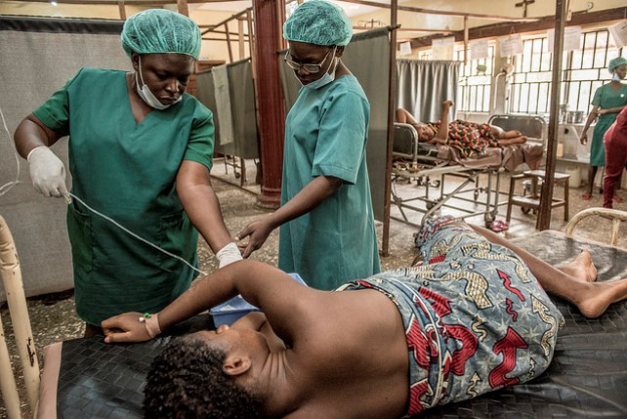
Session Objectives
Describe how they will apply the knowledge and skills obtained during the workshop
Provide feedback on the workshop
Notes:
The Maternal and Child Survival Program (MCSP)Follow
2018_02_13_Mile Four_104
Nigeria: Abakaliki town in Ebonyi State, Mile Four Hospital. Mile Four Hospital is a Catholic hospital run by the Medical Missionaries of Mary order of nuns. (MMM)
Uzonwanne Udochukwu "Udo" (glasses, blue scrubs), who is the head midwife and supervisor for the maternity/delivery floor, saw Mbam Amuche, 27, who was 7cm dilated. She delivered soon after she was admitted.
Udo monitors Amuche's condition and watches what another nurse is doing.
Photo: Karen Kasmauski/MCSP

Slide 211
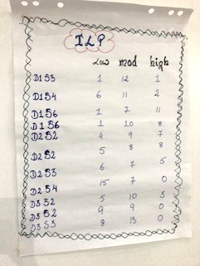
Individual Learning Plan
Notes:
Note to Facilitator: Please updated the ILP picture to reflect results from the current workshop

Slide 212
Discussion
What will you do differently as a result of this training?
How will you share the learning from this training with others from your facility/district/MPDSR committee?

Slide 213
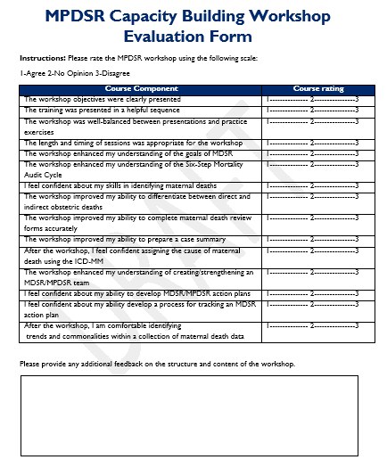
Workshop Evaluation
Please rate the MPDSR workshop using the following scale:
  1: Agree
  2: No Opinion
  3: Disagree

Slide 214

Thank you!
Na Gode!
Merci!
Asante Sana!
Shukran!
Tsikomo!
E Dupe!
Obrigado!
Misaotra!
Gracias!
Photo: Nigerian mother Ede holds her daughter
Notes:
The Maternal and Child Survival Program (MCSP)Follow
2018_02_12_Abakaliki_290
Nigeria: Abakaliki town in Ebonyi State, Azziokwu Primary Health Center
The center has about 15 patients daily, except on immunization day when they see about 70-100 women.
Jecinta Ede, 23, holds her daughter, Excellent, who is 8 months old. Jecinta has opted to have inserts put in for birth control.
Photo: Karen Kasmauski/MCSP

