Slide 1
The 2015 Zika Virus Outbreak:
How did it unfold and what did we learn about serious health consequences?

Slide 2
Evidence on Zika virus infection and its consequences has continued to evolve. Please consult the WHO, PAHO, and U.S. CDC websites for the most up-to-date and thorough information on prevention, diagnosis, and management of Zika virus infection and its consequences.
WHO: https://www.who.int/emergencies/diseases/zika/en/
PAHO:https://www.paho.org/hq/index.php?option=com_content&view=article&id=11585:zika-virus-infection&Itemid=41688&lang=en
CDC: https://www.cdc.gov/zika/index.html

Slide 3
Module Objectives
At the end of this module, learners will be able to:
Explain progression of the 2015 Zika virus outbreak
Identify potential features of congenital Zika syndrome (CZS)
Describe the potential impact of Zika virus infection during pregnancy

Slide 4
Module Topics
The beginnings of the Zika virus outbreak
Brazil’s growing public health emergency
Zika spreads throughout the Americas
Identifying link between ZIKV and microcephaly
Describing the impact of Zika virus infection during pregnancy
Defining a new syndrome

Slide 5
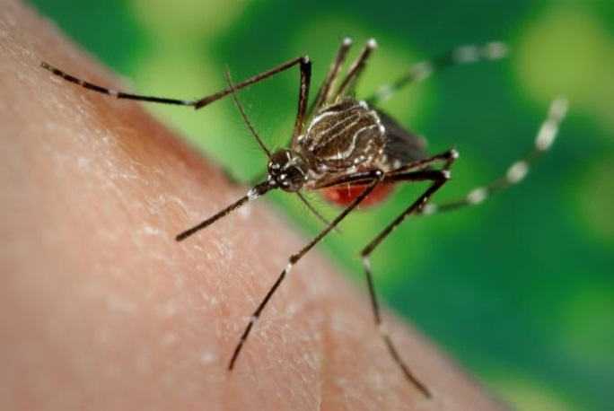
Module Introduction
Before the 2015 Zika outbreak in the Americas, the world was unprepared for the possibility that a bite from an infected mosquito could lead to congenital abnormalities.
Image source: "Zika Virus in Puerto Rico" by Fun Guy Inspections is licensed under CC BY-NC-SA 2.0
Notes:
Notes:
This module explores the history of the Brazilian Zika virus outbreak of 2015 and the subsequent discovery of the congenital Zika syndrome (CZS).

Slide 6
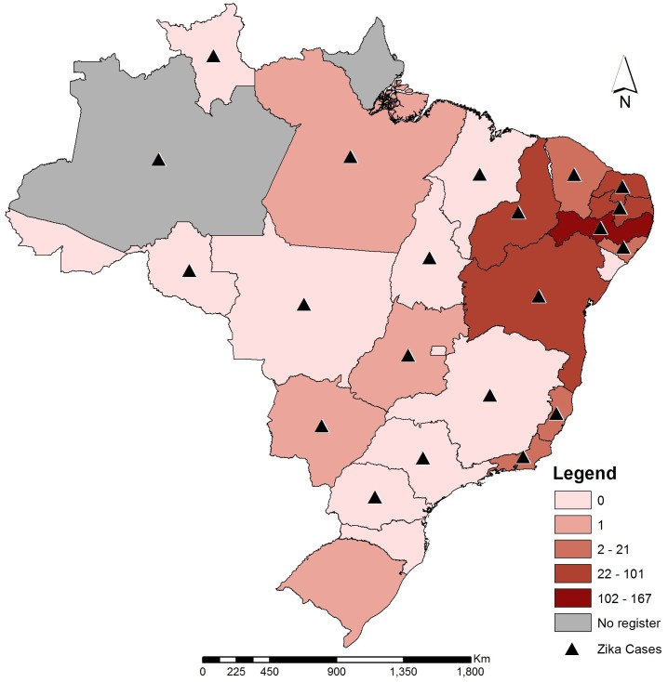
Beginnings of the Zika Virus Outbreak
First cases reported in Brazil between late 2014 and early 2015.
  Association between Zika virus infection and neurological signs and symptoms confirmed in adults
  Alarming increase in the number of congenital microcephaly cases
Image source: PLoS Negl Trop Dis. 2016 Jun; 10(6): e0004760.Published online 2016 Jun 3. doi: 10.1371/journal.pntd.0004760
Source: Brito, C.A. and Tenorio., M.T. , 2016
Notes:
Notes:
The Zika virus was discovered in 1947 in the Zika forest of Uganda. Prior to 2015 a few outbreaks had occurred in Africa, Southeast Asia, and the Pacific Islands, but the Brazilian outbreak of 2015 would quickly rise to a public health emergency of international concern. The first cases of the Zika virus coincided with cases of Guillain Barré syndrome, thus suggesting an association between Zika virus infection and neurological signs and symptoms in adults. In October 2015, the alarming number of cases of congenital microcephaly caused overwhelming concern in the public health sector.
Map information:
Brazilian federative units with Zika documented autochthonous cases (triangles) and number of microcephaly confirmed cases in each federal state (color shading of the affected Brazilian states) (source: Brazilian Ministry of Health and Secretary of Vigilance in Health).

Slide 7
Brazil’s Growing Public
Health Emergency
Oct. 2015
26 neonates with microcephaly hospitalized simultaneously, with 58 total cases in a single month
Nov. 2015
Zika virus identified in amniotic fluid of two pregnant women whose fetuses presented with microcephaly. National health emergency declared in Brazil.
Feb. 2016
WHO declares public health emergency of international concern (PHEIC)
Source: Brito, C.A. and Tenorio., M.T. , 2016
Notes:
Notes:
In October 2015 in Pernambuco state, Brazil, a single referral maternity hospital saw 26 neonates with microcephaly hospitalized simultaneously. In a single month there were 58 cases of microcephaly, far exceeding the total number of cases registered in previous years with the highest being 12 in 2014. In November 2015, the Zika virus was identified by RT-PCR in the amniotic fluid of two pregnant women whose fetuses presented with microcephaly. Before the Brazilian outbreak, only two cases of perinatal transmission had been described. Later in November 2015, the Ministry of Health of Brazil declared a national health emergency in the region. In February 2016, WHO declared a public health emergency of international concern (PHEIC). The PHEIC was ended November 2016.

Slide 8
Zika Spreads in the Americas
January and April 2016: 28 countries reported autochthonous cases
July 2016: 40 countries reported locally-acquired cases
By January 2018: 3,720 confirmed cases of CZS reported
5 countries reported sexual transmission
Image source: Organización Panamericana de la Salud / Organización Mundial de la Salud. Actualización Epidemiológica, 26 de julio de 2017, Washington, D.C. OPS/OMS. 2017
Notes:
Notes:
Zika continued to spread from Brazil through the rest of the Americas. Between January and April 2016, 28 countries reported autochthonous cases of Zika infection. Today that number is 48. In July 2016, 40 countries reported locally-acquired cases. By January 2018, a total of 3,720 confirmed cases of congenital zika syndrome (CZS) were reported across 48 countries, most in Brazil and Colombia. Five countries reported sexual transmission in the Americas: Argentina, Chile, Canada, Peru and the US.
Source: PAHO

Slide 9
Knowledge Check
What neurological disorder is associated with Zika infection in adults?
Epilepsy
Guillain Barré Syndrome
Neuropathy

Slide 10
Knowledge Check Answer
The first cases of the Zika virus coincided with cases of Guillain Barré syndrome (GBS) suggesting association between Zika virus infection and neurological signs and symptoms in adults. GBS is a rare neurological disorder in which the body’s immune system attacks the nervous system, causing weakness and sometimes paralysis.

Slide 11
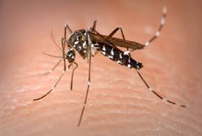
Finding the Link Between ZIKV Infection and Microcephaly
Other arboviral infections endemic and epidemic in the region were not associated with congenital abnormalities.
Zika virus had a greater affinity for the nervous system versus other arboviruses.
Chikungunya had not been detected in many northeast states of Brazil at onset of the outbreak.
In Brazil, most mothers reported symptoms compatible with Zika virus infection in their first trimester, coinciding with Zika virus outbreak in the region.
Image source: https://commons.wikimedia.org/wiki/File%3AAedes_Albopictus.jpg. By James Gathany/CDC [Public domain], via Wikimedia Commons from Wikimedia Commons
Source: Brito, C.A. and Tenorio., M.T. , 2016
Notes:
Notes:
Experts worked persistently to rule out other similar diseases in the region such as dengue and chikungunya. Tests for dengue, chikungunya, Toxoplasma gondii, rubella, cytomegalovirus, herpes simplex, HIV, Treponema pallidum, and parvovirus B19 were all negative. They concluded Zika favored the nervous system compared to the other diseases tested and was associated with congenital abnormalities.

Slide 12
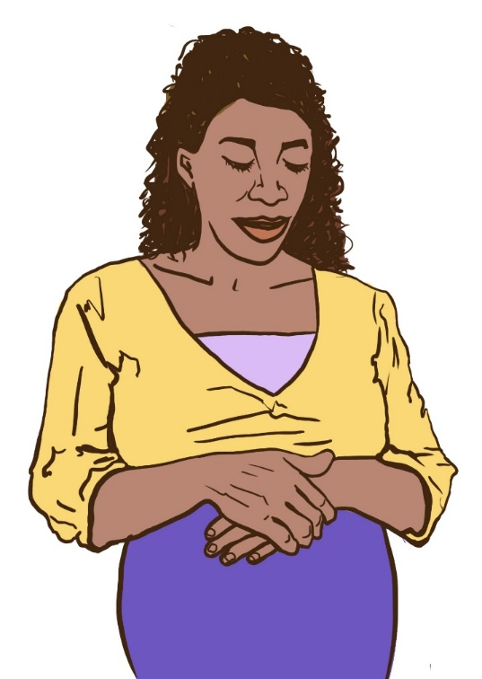
May 2016: WHO on Zika Virus
During Pregnancy
WHO concluded that Zika infection during pregnancy can lead to:
  A distinct pattern of birth defects
  Fetal CNS abnormalities and microcephaly resulting in epilepsy, hearing, visual, and psychomotor impairment, swallowing problems, and joint contractures
  Miscarriages and stillbirths
  Prematurity and low birth weight
Image source: Jhpiego, 2018
Source: Costello, A., Dua. T., et. Al. 2016
Notes:
Notes:
Based on a systematic review of the literature through May 2016, WHO concluded that Zika virus infection during pregnancy is a cause of congenital brain abnormalities, including microcephaly; and that Zika virus is a trigger for Guillain-Barré syndrome. The range of abnormalities seen and the likely causal relationship with Zika virus infection suggested the presence of a new congenital syndrome. WHO set in place a process for defining the spectrum of this syndrome. After the expert meeting in Recife, WHO defined the syndrome associated with congenital Zika virus infection. In June 2016, WHO published an initial description of the syndrome and in July the experts worked on identifying the most common features to define the syndrome.

Slide 13
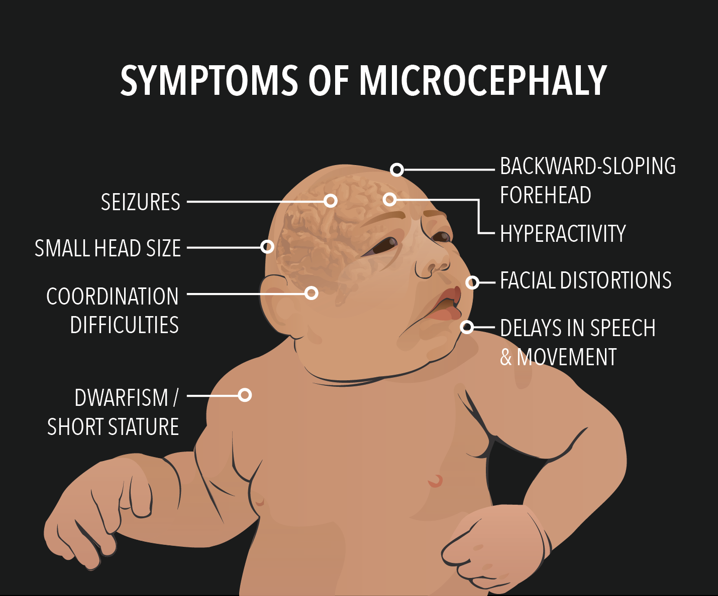
July 2016: Defining a New Syndrome
Features of congenital Zika syndrome (CZS) include:
Severe microcephaly, sometimes with partially collapsed skull
Decreased brain tissue with specific pattern of brain damage, including subcortical calcifications
Damage to back of eye, including macular scarring, focal retinal pigmentary mottling
Congenital contractures, e.g., clubfoot or arthrogryposis
Hypertonia restricting movement soon after birth
Image source: Beth.herlin (Own work) [CC BY-SA 4.0 (http://creativecommons.org/licenses/by-sa/4.0)], via Wikimedia Commons from Wikimedia Commons
Source: Moore, CA, Staples JE, 2017
Source: https://www.cdc.gov/pregnancy/zika/testing-follow-up/zika-syndrome-birth-defects.html
Notes:
Notes:
Scientists from Brazil, Colombia, Argentina, the United States, WHO/PAHO, and the CDC, met in July 2016 to analyze Zika virus infection and its effects on the child. As a result, congenital Zika syndrome or CZS was defined. Congenital Zika syndrome is unique to fetuses and infants infected with Zika virus before birth, and is characterized by the following features:
Severe microcephaly in which the skull has partially collapsed
Decreased brain tissue with a specific pattern of brain damage, including subcortical calcifications
Damage to the back of the eye, including macular scarring and focal pigmentary retinal mottling
Congenital contractures, such as clubfoot or arthrogryposis
Hypertonia, increased muscle tone and involuntary muscle activity

Slide 14
What other abnormalities may be present in infants with congenital Zika infection?
Brain atrophy and asymmetry, abnormally formed or absent brain structures, hydrocephalus, neuronal migration disorders
Excessive and redundant scalp skin
Neurologic findings may include hyperreflexia, irritability, tremors, seizures, brainstem dysfunction, and dysphagia
Eye abnormalities may include, but are not limited to, focal pigmentary mottling and chorioretinal atrophy in the macula, optic nerve hypoplasia, cupping, and atrophy, other retinal lesions, iris colobomas, congenital glaucoma, microphthalmia, lens subluxation, cataracts, and intraocular calcifications

Slide 15
Knowledge Check
The Zika virus appears to have a greater impact on which system of the human body?
Nervous
Respiratory
Endocrine

Slide 16
Knowledge Check Answer
Zika virus infection appears to have a greater impact on the central nervous system.

Slide 17
Summary
Brazil’s Zika virus outbreak likely began in late 2014
The first cases of Zika virus infection in adults coincided with cases of Guillain Barré syndrome
In 2015, the alarming number of microcephaly cases in Brazil prompted an urgent search for a common cause
WHO declared PHEIC in February 2016 and ended it November 2016
WHO concluded Zika infection during pregnancy can lead to a distinct pattern of birth defects (CZS)
The long-term health and social consequences of CZS appear to be significant

Slide 18
Module Resources
Congenital Zika Syndrome and Other Birth Defects
https://www.cdc.gov/pregnancy/zika/testing-follow-up/zika-syndrome-birth-defects.html

Slide 19
Works Cited
Brito, CA, and Tenorio., MT. One year after the Zika virus outbreak in Brazil: from hypotheses to evidence Rev Soc Bras Med Trop. 2016 Sep-Oct;49(5):537-543. doi: 10.1590/0037-8682-0328-2016.
Costello, A, Dua, T, Duran,P, Gülmezoglu, M, Oladapo, OT, Perea, W, et al. Defining the syndrome associated with congenital Zika virus infection. Bulletin of the World Health Organization 2016;94:406-406A. doi: http://dx.doi.org/10.2471/BLT.16.176990
Guerra, J, and Van der Lin, V. (2017, March 29). Long-term management of congenital Zika virus syndrome. [Audio podcast]. Retrieved from http://www.who.int/mediacentre/multimedia/podcasts/2017/longterm-management-zika/en/.
Moore, CA, Staples JE, Dobyns, WB, Pessoa, A, Ventura CV, Fonseca EBD, Ribeiro EM, Ventura LO, Neto NN, Arena JF, Rasmussen SA. Characterizing the pattern of abnormalities in Congenital Zika Syndrome for pediatric clinicians. JAMA Pediatrics. 2017;171(3):288-295. doi:10.1001/jamapediatrics.2016.3982.
Rasmussen SA, Jamieson DJ, Honein MA, Petersen LR. Zika Vius and Birth Defects - Reviewing the Evidence for Causality.N Engl J Med2016;13. doi:10.1056/NEJMsr1604338. pmid:27074377

Slide 20
Acknowledgements
MCSP is a global USAID program to introduce and support high-impact health interventions in 25 priority countries to help prevent child and maternal deaths. MCSP supports programming in maternal, newborn, and child health, immunization, family planning and reproductive health, nutrition, health systems strengthening, water/sanitation/hygiene, malaria, prevention of mother-to-child transmission of HIV, and pediatric HIV care and treatment. MCSP will tackle these issues through approaches that also focus on household and community mobilization, gender integration, and digital health, among others.
This learning module is made possible by the generous support of the American people through the United States Agency for International Development (USAID) under the terms of the Cooperative Agreement AID-OAA-A-14-00028. The contents are the responsibility of the Maternal and Child Survival Program and do not necessarily reflect the views of USAID or the United States Government.

