Slide 1
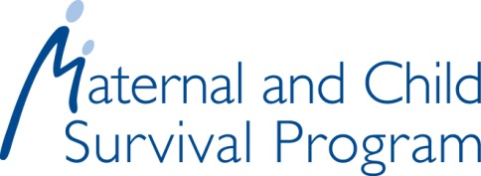
Care for Women at Risk for Zika Infection: Overview of the Basics
Current as of March 2020
Notes:
Notes: this module is designed to be delivered as an interactive session where facilitators pause every 1-2 slides for discussion. Depending on length of discussion, it will take approximately 1.5-2.5 hours to complete this session.

Slide 2
Evidence on Zika virus infection and its consequences has continued to evolve. Please consult the WHO, PAHO, and U.S. CDC websites below for the most up-to-date and thorough information on prevention, diagnosis, and management of Zika virus infection and its consequences.
WHO: https://www.who.int/emergencies/diseases/zika/en/
PAHO:https://www.paho.org/hq/index.php?option=com_content&view=article&id=11585:zika-virus-infection&Itemid=41688&lang=en
CDC: https://www.cdc.gov/zika/index.html

Slide 3
Module Objectives
After completing this module, learners will be able to:
Identify three common modes of Zika transmission
Describe the clinical presentation of Zika infection
Describe the clinical management of Zika infection
Explain how Zika infection can impact pregnancy
Provide quality care for pregnant women at risk for Zika infection
Identify opportunities to provide family planning counseling during antenatal care (ANC) in the context of Zika outbreaks
Apply knowledge and decision-making skills to case studies
Notes:
Notes:
Zika infection during pregnancy can have devastating outcomes causing pregnancy loss and stillbirth, fetal growth problems, severe birth defects, and developmental issues. Although the 2015 Zika outbreak has largely passed, antenatal care providers need to be prepared to help patients prevent or manage a Zika infection. This module will address how providers can care for women at risk of Zika infection.

Slide 4
Module Topics
Zika: Transmission, clinical presentation, and management
Prevention strategies
Zika in pregnancy and congenital Zika syndrome (CZS)
Care of pregnant women at risk for Zika infection
Zika case studies
Notes:
Notes:
This module contains five topics related to caring for women at risk of Zika infection.

Slide 5
TOPIC 1 Zika: Transmission, Clinical Presentation, and Management

Slide 6
What is Zika?
Notes:
Notes:
Zika virus is a type of arbovirus related to viruses that cause dengue, yellow fever, tickborne encephalitis, and West Nile viruses.

Slide 7
Common Modes of Transmission
Mosquito bites (most common)
During pregnancy to a fetus
Sexual transmission
Notes:
Notes:
There are three common modes of transmission: 1. mosquito bites, which are the most common, 2. during pregnancy, also referred to as vertical transmission, and 3. sexual transmission. Transmission through blood transfusion is theoretically possible but has not been confirmed. Laboratory exposure is possible and has been confirmed but has not been commonly reported.

Slide 8
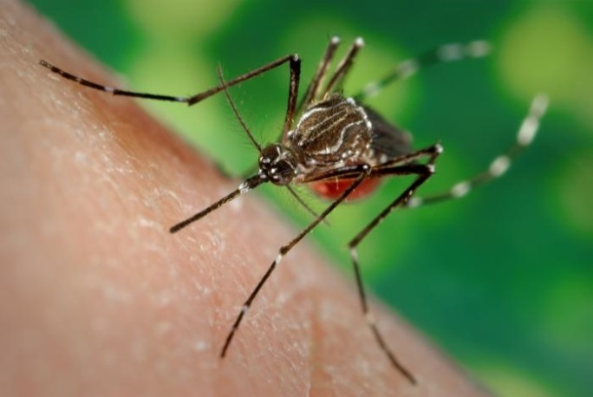
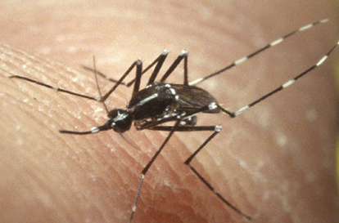
Transmission: Mosquito Bites
Zika is primarily transmitted by 2 species of mosquitoes:
Aedes aegypti mosquito
Aedes albopictus mosquito
Image source: "Zika Virus in Puerto Rico" by Fun Guy Inspections is licensed under CC BY-NC-SA 2.0
Image source: Wikimedia commons, public domain
Notes:
Notes:
The Zika virus is primarily spread through the bite of an infected female mosquito of the Aedes species. Mosquito bites can occur during the day and at night.

Slide 9
Transmission: During Pregnancy
Zika infection can be passed to a fetus during pregnancy.
Image source: Jhpiego, 2018.
Source: CDC (2017). Zika 101 PPT
Notes:
Notes:
Vertical transmission or transmission of the virus during pregnancy can occur at any stage in pregnancy. In perinatal transmission, a pregnant woman is typically infected with the Zika virus within +/-2 weeks of delivery. There is limited information to date on the long term outcomes of postnatal transmission. There are currently no confirmed cases of Zika transmission via breast milk.

Slide 10
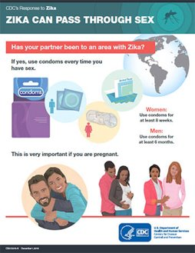
Transmission: Sexual
Image source: https://www.cdc.gov/zika/fs-posters/text

Slide 11
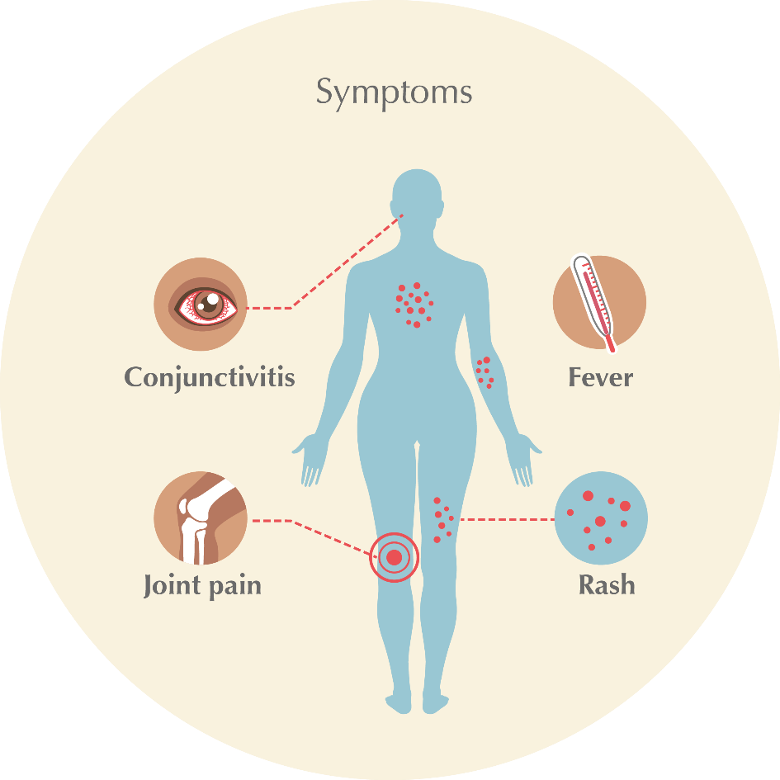
Clinical Presentation of Zika Infection
Most people infected with Zika are asymptomatic
Image source: CDC (2017). Zika 101 [PowerPoint slides]. Retrieved from https://www.cdc.gov/zika/comm-resources/
Notes:
Notes:
The most common symptoms are: fever, rash, joint pain, and conjunctivitis. Symptoms typically last 4 to 10 days. The infection is rarely fatal. In some cases, Guillain-Barré syndrome can occur but is not common.

Slide 12
Clinical Management of Zika Infection
No vaccine or antiviral treatments exist
Treat symptoms
Avoid aspirin and non-steroidal anti-inflammatory drugs (NSAIDS)
.
Notes:
Notes:
Providers can only treat the symptoms of Zika infection. Symptoms should be treated with rest, fluids to prevent dehydration, and acetaminophen to reduce fever and pain. Acetaminophen can be given during pregnancy in the absence of drug allergy. Pregnant women should avoid aspirin and other non-steroidal anti-inflammatory drugs (NSAIDS).
Image source: Jhpiego, iStock 2018

Slide 13
Knowledge Check
What are the ways an infant can become infected with the Zika virus?
During pregnancy
During delivery/perinatal
After delivery by mosquito bite
Airborne

Slide 14
Knowledge Check Answer
An infant can become infected by the Zika virus in the following ways:
during pregnancy
during delivery/perinatal
after delivery by mosquito bite
The Zika virus is not transmitted through the air.

Slide 15
Prevention Strategies: Overview
Follow vector control measures
Avoid mosquito bites
Prevent unintended pregnancies
Prevent infection during pregnancy
Use universal infection prevention and control strategies for delivery
Notes:
Notes:
Since no vaccine or antiviral treatment exists for Zika, prevention strategies must be a primary focus.

Slide 16
Prevention: Vector Control
Cover water storage containers
Scrub containers to remove mosquito eggs
Empty standing water
Notes:
Notes:
Counseling women and their families on the importance of vector control is a critical component of Zika prevention. Providers should encourage women and families to do the following:
cover water storage containers at all times with a cover that is tight fitting and does not warp or touch the water.,
scrub walls of water storage containers once a week with a brush to remove mosquito eggs,
empty standing water from indoor plant trays, and
once a week, empty and scrub with a brush, turn over, cover, or throw out items that hold water.
Additionally, women and their families should share and participate in vector control measures within their community to initiate community-wide source reduction campaigns.

Slide 17
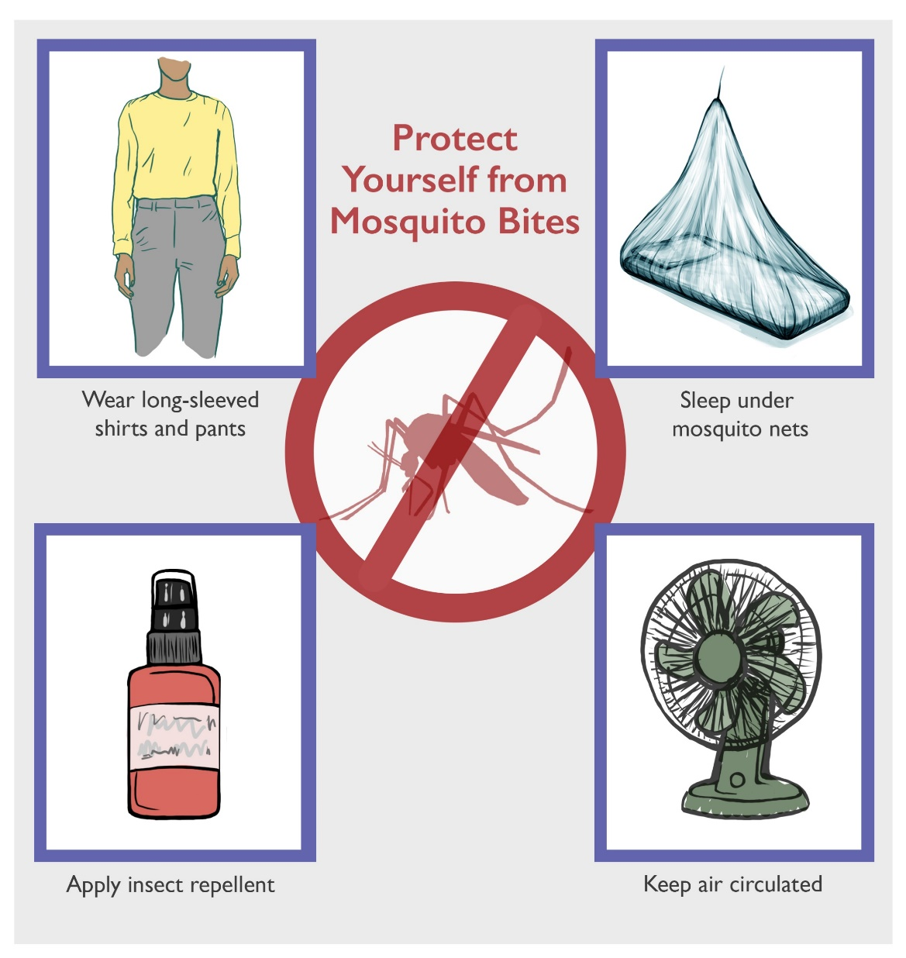
Prevention: Avoid Mosquito Bites
Image source: Jhpiego, 2018
Notes:
Notes:
Mosquitos that carry ZIKV often bite during daytime hours and inside homes. These mosquitos also spread dengue and chikungunya. Therefore, avoiding mosquito bites is critical in preventing Zika and other related infections. There are several ways to avoid mosquito bites such as wearing long-sleeved shirts and long pants, using insect repellent, and using a mosquito bed net for daytime sleeping. If available, use air conditioning or screens on windows and doors, and repair holes in screens to keep mosquitos outside. If offered, allow vector control teams into the home and community to apply larvicide.

Slide 18
Prevention: Avoid Mosquito Bites
Guidelines for Using Insect Repellent
Use repellents containing DEET, picaridin, oil of lemon eucalyptus, or IR3535
Apply only to exposed skin and clothing
Do not use on wounds, irritated skin, eyes, mouth
Do not use repellent on babies <2 months old
No oil of eucalyptus on children <3 years old
If a mosquito bites, reapply the repellent
Notes:
Notes:
Using effective insect repellents correctly and consistently can reduce the risk of getting mosquito bites. Insect repellent is safe for use during pregnancy and breastfeeding if these guidelines are followed. Always follow instructions on product labels and reapply as recommended. Women are often primary caretakers for children, so related messages may be appropriate for these clients. Spray repellent onto an adult’s hands and then apply to a child’s face. Do not use oil of lemon eucalyptus on children under 3 years old.

Slide 19
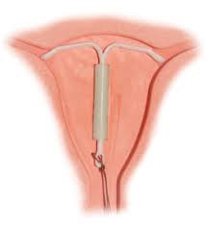
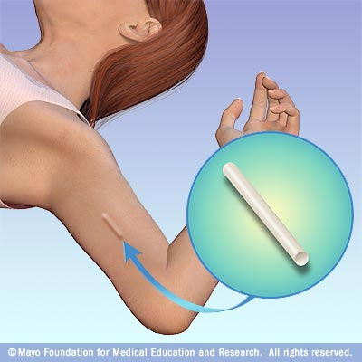
Prevention: Prevent Unintended Pregnancies
Preventing unintended pregnancy can be a primary strategy for preventing pregnancies affected by Zika infection.
Use effective birth control consistently and correctly.
Women need access to informed choice about family planning options.
Image source: Jhpiego, 2018
Image source: Jhpiego, 2018
Notes:
Notes:
Preventing unintended pregnancy during a Zika virus outbreak can be a primary strategy to prevent poor pregnancy and birth outcomes linked to Zika infection during pregnancy. The best way for sexually active women and their partners to reduce the risk of unintended pregnancy is to use effective birth control methods consistently and correctly. High to moderate effective methods include IUDs, implants, pills, rings, patches, and the depot medroxyprogesterone acetate (DMPA) injection. It is also important to help women make an informed choice about their family planning options.

Slide 20
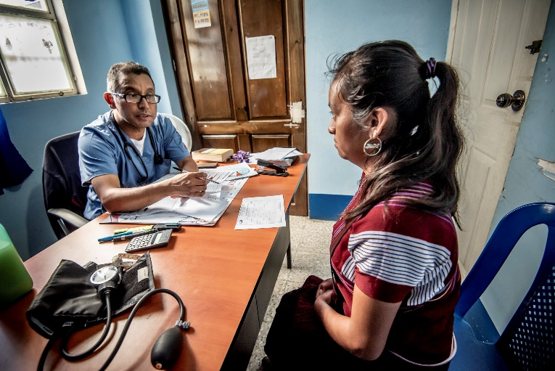
Prevention: Contraceptive Counseling During a Zika Virus Outbreak
Key Discussion Topics:
Pregnancy intentions and reproductive life plan
Strategies to prevent unintended pregnancy
Available contraceptive methods
Correct and consistent use of condoms
Image source: Karen Kasmauski/MCSP/Flickr. 2018.
Notes:
Notes:
During a Zika virus outbreak, providers should discuss with women of reproductive age and couples who choose to delay or avoid becoming pregnant their pregnancy intentions and reproductive life plan and strategies to prevent unintended pregnancy. Providers should provide information about birth control methods that best meet the client’s needs, including the use of the most effective contraceptive methods such as long acting reversible contraceptives or LARC. It is equally important to discuss the role of condoms to reduce the risk for sexually transmitted infections including Zika.

Slide 21
Prevent Transmission During Pregnancy
Follow vector control guidelines
Follow personal protection guidelines
Prevent sexual transmission through condom use every time or abstinence throughout pregnancy
Image source: Jhpiego, 2018.
Notes:
Notes:
To prevent transmission during pregnancy, all women of reproductive age should follow vector control and personal protection guidelines. Sexual transmission can be prevented through condom use with every act of intercourse or by practicing abstinence throughout pregnancy.

Slide 22
Knowledge Check
Which of the following discussion topics should providers address when providing contraceptive counseling during a Zika virus outbreak?
Pregnancy intentions and reproductive life plan
Strategies to prevent unintended pregnancy
Available contraceptive methods
Using condoms correctly and consistently

Slide 23
Knowledge Check Answer
All topics listed below should be discussed when providing contraceptive counseling during a Zika virus outbreak!
Pregnancy intentions and reproductive life plan
Strategies to prevent unintended pregnancy
Available contraceptive methods
Using condoms correctly and consistently

Slide 24
TOPIC 2 Zika in Pregnancy and Congenital Zika Syndrome (CZS)

Slide 25
Zika in Pregnancy: Question #1
Does Zika infection really cause
adverse pregnancy and birth outcomes?

Slide 26
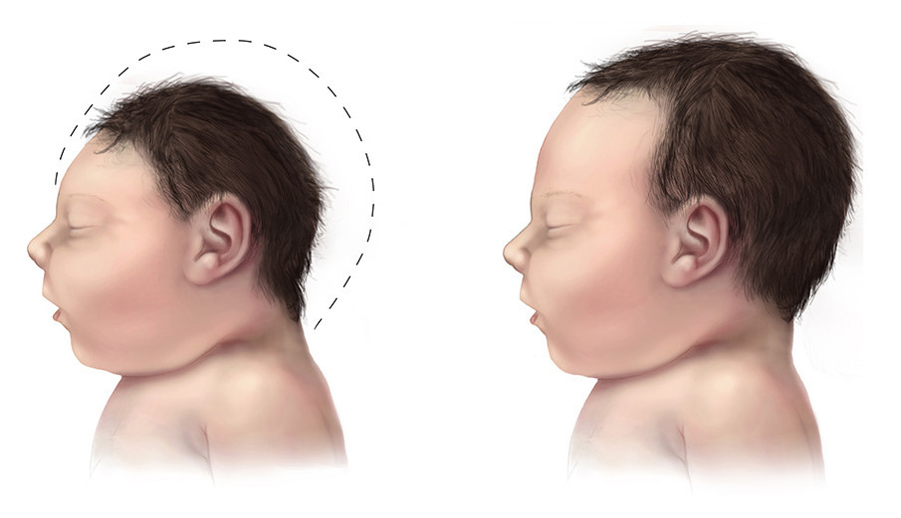
Yes! There is evidence that Zika is a cause of microcephaly as well as other birth defects.
Image source: Flicker (CC) www.dcmot.com/what-is-zika-virus-its-transmission-symptom...
Source: WHO 2016
Notes:
Notes:
Zika can cause adverse pregnancy and birth outcomes such as microcephaly and other severe fetal brain abnormalities. There is no evidence to suggest that these birth defects are caused by mosquito control efforts (spraying). Congenital abnormalities will be presented in question 4.

Slide 27
Risk of Zika-Related Birth Defects
Zika infection in early pregnancy increases the risk of birth defects.
Research has shown that birth defects may be more common among babies whose mothers were infected with Zika virus during first trimester (first three months) of pregnancy.
Image source: Jhpiego 2018
Sources: Johansson MA, et al. 2016 and CDC vital signs
Notes:
Notes:
Birth defects were reported in a higher proportion of babies whose mothers were infected with Zika virus during the first trimester (first three months) of pregnancy.
In one large study, the proportion of babies affected by birth defects was similar for women with Zika infection during pregnancy who experienced symptoms compared to those who did not experience symptoms.

Slide 28
Zika can affect women at any time during their pregnancy
Protection against Zika is important throughout pregnancy
However, in a recent study, the proportion of fetuses and infants with Zika virus–associated birth defects was highest among those with first trimester Zika virus infections
Scientists are still studying the potential impacts of Zika virus infection at different times in pregnancy
Notes:
Notes:
Zika can affect women at any time during their pregnancy. Protection against Zika is important throughout pregnancy.
Reynolds MR, Jones AM, Petersen EE, et al. Vital Signs: Update on Zika Virus–Associated Birth Defects and Evaluation of All U.S. Infants with Congenital Zika Virus Exposure — U.S. Zika Pregnancy Registry, 2016. MMWR Morb Mortal Wkly Rep 2017;66:366-373. DOI: http://dx.doi.org/10.15585/mmwr.mm6613e1External

Slide 29
What are the potential abnormalities that Zika infection may cause in an infected fetus?

Slide 30
Congenital Zika Syndrome (CZS)
Congenital abnormalities:
Loss of brain tissue and microcephaly
Brain tissue calcifications
Eye defects
Hearing loss
Impaired growth
Contractures or limited range of joint and muscle motion
Image source: Flicker (CC) www.dcmot.com/what-is-zika-virus-its-transmission-symptom...
Sources: CDC (2017). Zika Virus: Information for Clinicians PPT and Linden V, et al. 2016.
Notes:
Notes:
Congenital Zika syndrome (CZS) has unique features including birth defects like microcephaly and other health and development problems. However, there is still more to learn about how Zika affects mothers and babies. Research is ongoing regarding the longer term effects of congenital Zika infection on development and learning in children.
Some babies with possible Zika infection during pregnancy might look healthy at birth but can develop long-term health problems as they grow. Careful monitoring and evaluation of children born to mothers with evidence of possible Zika virus infection during pregnancy is essential to ensure babies receive the care they need.

Slide 31
TOPIC 3
Care of Pregnant Women at Risk of Zika Infection

Slide 32
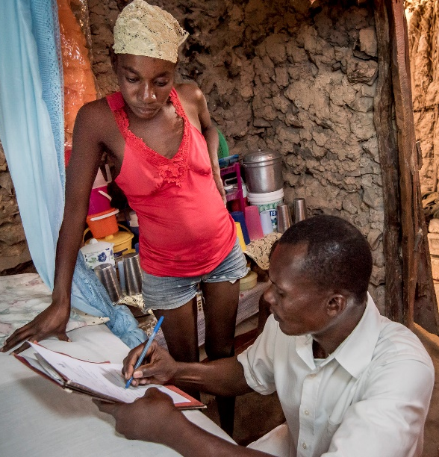
Antenatal Care (ANC) Visits
During ANC visits:
Assess for Zika symptoms
Educate on Zika signs and symptoms
Discuss prevention strategies
Provide emotional support
Image source: Karen Kasmauski/MCSP/Flickr. 2017.
Notes:
Notes:
Antenatal care visits should be scheduled or encouraged according to national standards. During the first visit, educate women on signs and symptoms to look for and advise them to present early if they experience any symptoms. At each antenatal care visit, providers should assess women for symptoms of Zika. Preventing Zika infections during pregnancy should also be discussed especially sexual transmission risk and the importance of condom use or abstinence throughout pregnancy. During the visit, providers should discuss family planning methods and document the mother’s desired post partum method prior to labor, before the 36th week of pregnancy. Emotional support should also be provided as many women will be concerned throughout their pregnancy.

Slide 33
Testing Pregnant Women for Zika
Test pregnant women according to WHO recommendations
Adhere to national/local norms and laboratory capacity
WHO Decision Chart
Image source: http://www.who.int/csr/resources/publications/zika/pregnancy-management/en/
Notes:
Notes:
WHO has two decision-charts one for the Care of pregnant women living in areas with ongoing Zika virus transmission and one for the Care of pregnant women with a history of travel to areas with ongoing Zika virus transmission.
Decision chart: http://www.who.int/csr/resources/publications/zika/pregnancy-management/en/

Slide 34
Ultrasound (US) Care in Pregnancy
WHO recommends one US before 24 weeks gestation for all pregnant women.
Some abnormalities associated with Zika infection may be difficult to detect on US.
Counsel pregnant women on the possible limitations and benefits of US.
Image source: "usound.06" by jayntguru is licensed under CC BY-NC-SA 2.0
Notes:
Notes:
The World Health Organization recommends one ultrasound scan before 24 weeks of gestation for all pregnant women. However, abnormalities associated with congenital Zika infection may be difficult to detect and depend on the capacity of the ultrasound provider and their equipment. Pregnant women who receive ultrasounds should be counseled on the possible limitations and benefits of ultrasound before and after this service.

Slide 35
Ultrasound for Effects of Zika Requires Special Expertise
A range of findings may be present
Microcephaly, ventriculomegaly
Intra-cranial calcifications and/or cysts
Atrophy and callosal agenesis
Micro-ophthalmia and eye calcifications
Inadequate growth and/or amniotic fluid
Referral to an US specialist is needed for detection and verification of suspected abnormal findings
Notes:
Notes:
Zika infection is associated with a range of fetal brain and eye abnormalities on ultrasound, as well as growth restriction and lack of adequate amniotic fluid. Advanced training may be required to detect abnormalities such as the ones listed onscreen. Referral to specialist is needed for detection and verification of suspected abnormal findings on ultrasound.

Slide 36
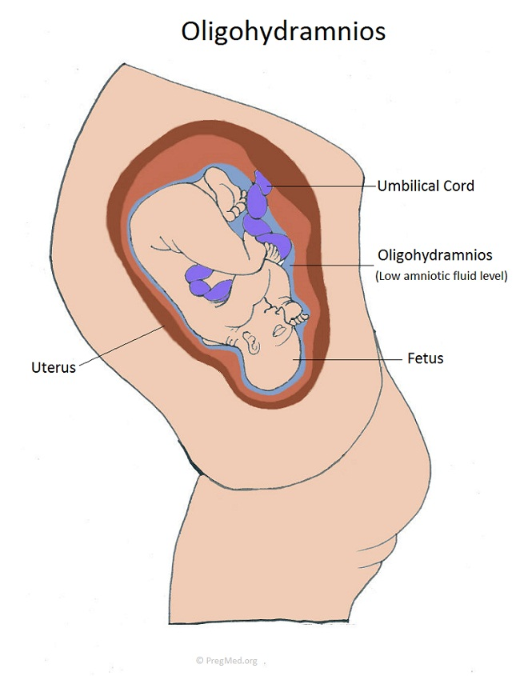
Suspicious Findings in Women with a Previous Infection
Intrauterine fetal demise (IUFD)
Growth restriction
Oligohydramnios
Image source: http://www.pregmed.org/oligohydramnios.htm
Notes:
Notes:
Other findings that may be associated with a Zika virus infection include intrauterine fetal demise or death, intrauterine growth restriction, and oligohydramnios, or insufficient amniotic fluid surrounding the baby.

Slide 37
Specialized Care Needed for Suspected Zika Infection During Pregnancy
During ANC:
Good documentation of any laboratory testing
Consultation with specialists if available
Counseling for mother and family: possible risks and available care in pregnancy and for infant
Emotional support
Postnatal Referrals:
Pediatric neurologist or specialist
Early child development specialist
Vision, hearing, physical/occupational therapy

Slide 38
Knowledge Check
Based on WHO recommendations, when should pregnant women be tested for Zika infection?
At the first ANC visit
At 18 to 20-week gestation
Only when they are symptomatic
When they have a clinical history suggesting ZIKV during pregnancy

Slide 39
Knowledge Check Answer
WHO recommends that all pregnant women with a clinical history suggesting ZIKV during pregnancy should be tested for infection.

Slide 40
Postpartum Family Planning (PPFP)
PPFP prevents potential birth defects in unplanned pregnancies
Allows women and families to practice birth spacing to prevent an unplanned pregnancy
Should be offered at each ANC visit
Image source: Karen Kasmauski/MCSP/Flickr. 2018.
Notes:
Notes:
Postpartum Family Planning (PPFP) counseling is an important part of antenatal care as it can help to prevent potential birth defects in unplanned pregnancies. PPFP counseling should be offered at each ANC visit and the woman’s choice should be documented by the 36th week of pregnancy. Planned pregnancies allow women to actively prevent Zika exposure before and during pregnancies. PPFP counseling and method uptake after delivery allows for healthy birth spacing. It is recommended that women wait at least 3 years between births for the health of her children and herself.

Slide 41
PPFP: Breastfeeding and Lactation Amenorrhea (LAM)
Include comprehensive counseling on all methods including LAM
LAM protects from pregnancy for up to 6 months if the following 3 criteria are followed:
Exclusive breastfeeding/breastfeeding on demand
No return of menses
Less than 6 months postpartum

Slide 42
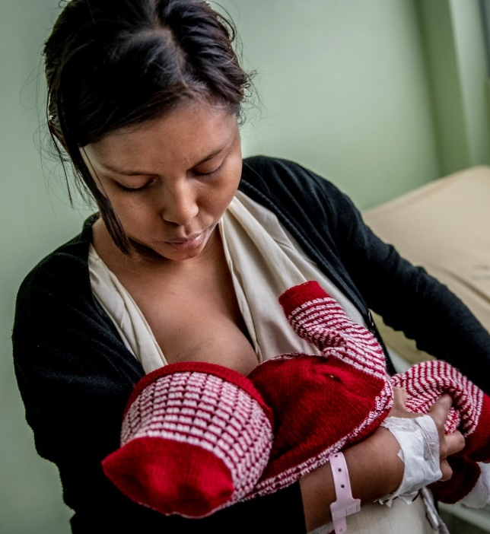
PPFP: Breastfeeding and Zika
There have been no known transmissions due to breastfeeding.
All mothers are encouraged to continue breastfeeding.
Breastfeeding can prevent pregnancy if LAM is followed.
Image source: Karen Kasmauski/MCSP/Flickr. 2018.
Notes:
Notes:
Women living in areas of local Zika transmission, whether or not they have been infected with Zika, should be encouraged to continue to breastfeed. Additionally, breastfeeding can prevent pregnancy if LAM is followed.

Slide 43
Family Planning…an Opportunity
Preventing unintended pregnancies is a primary strategy to reduce Zika-related birth defects
Regardless of local status of Zika transmission:
Promote capacity-building for high-quality FP service delivery
Provide comprehensive and updated evidence-based counseling on all options and methods
Notes:
Notes:
Pregnancy prevention for women who do not want to be pregnant is a primary strategy to reduce Zika-related birth outcomes. Family planning creates an opportunity to promote capacity-building, high-quality FP service delivery regardless of local status of Zika transmission. Providers can offer comprehensive and updated evidence-based counseling on all options and methods to all women of reproductive age.

Slide 44
Family Planning Counseling
Discuss all available methods, including:
Efficacy
Procedure/instructions for use
Non-contraceptive benefits
Mechanism of action
Potential side effects and bleeding changes
Eligibility for chosen method
Follow-up plans
Notes:
Notes:
Family planning counseling entails many components. The components listed onscreen should be included in family planning client-centered discussions.

Slide 45
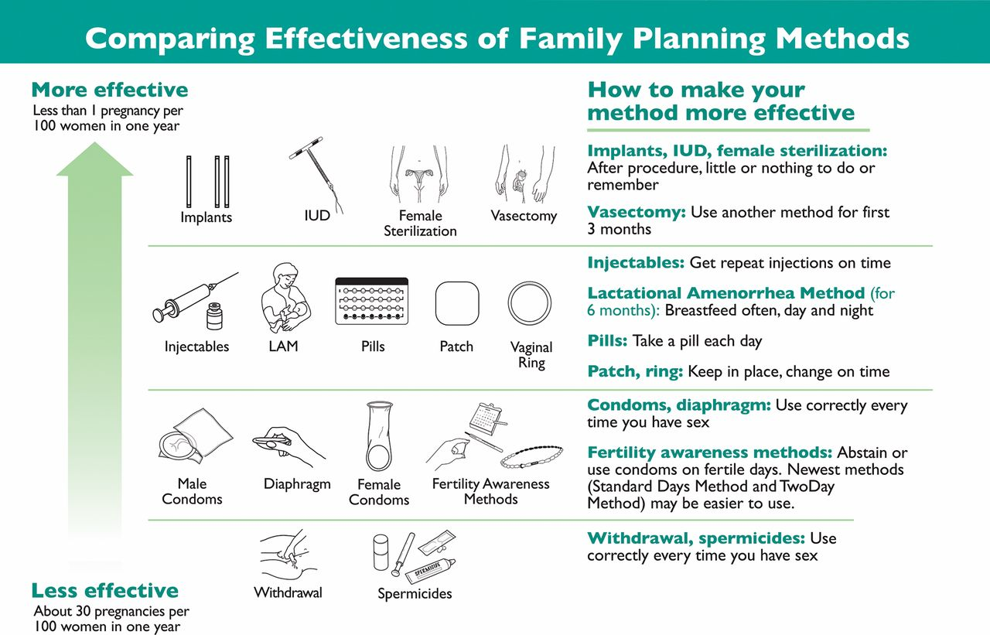
Image source: Stanback, S, Steiner, M, Dorflinger, L , Solo, J, and Cates, W. WHO Tiered-Effectiveness Counseling Is Rights-Based Family Planning. Global Health: Science and Practice Sep 2015, 3 (3) 352-357.
Notes:
Notes:
This job aid illustrates the WHO Model of Tiered Contraceptive Effectiveness. Providers can use this job aid to help women make an informed choice regarding contraceptive use.

Slide 46
Zika Case Studies
Notes:
Notes:
The following series of Zika case studies offers participants/learners a chance to apply their understanding of providing care for women at risk of Zika infection.

Slide 47
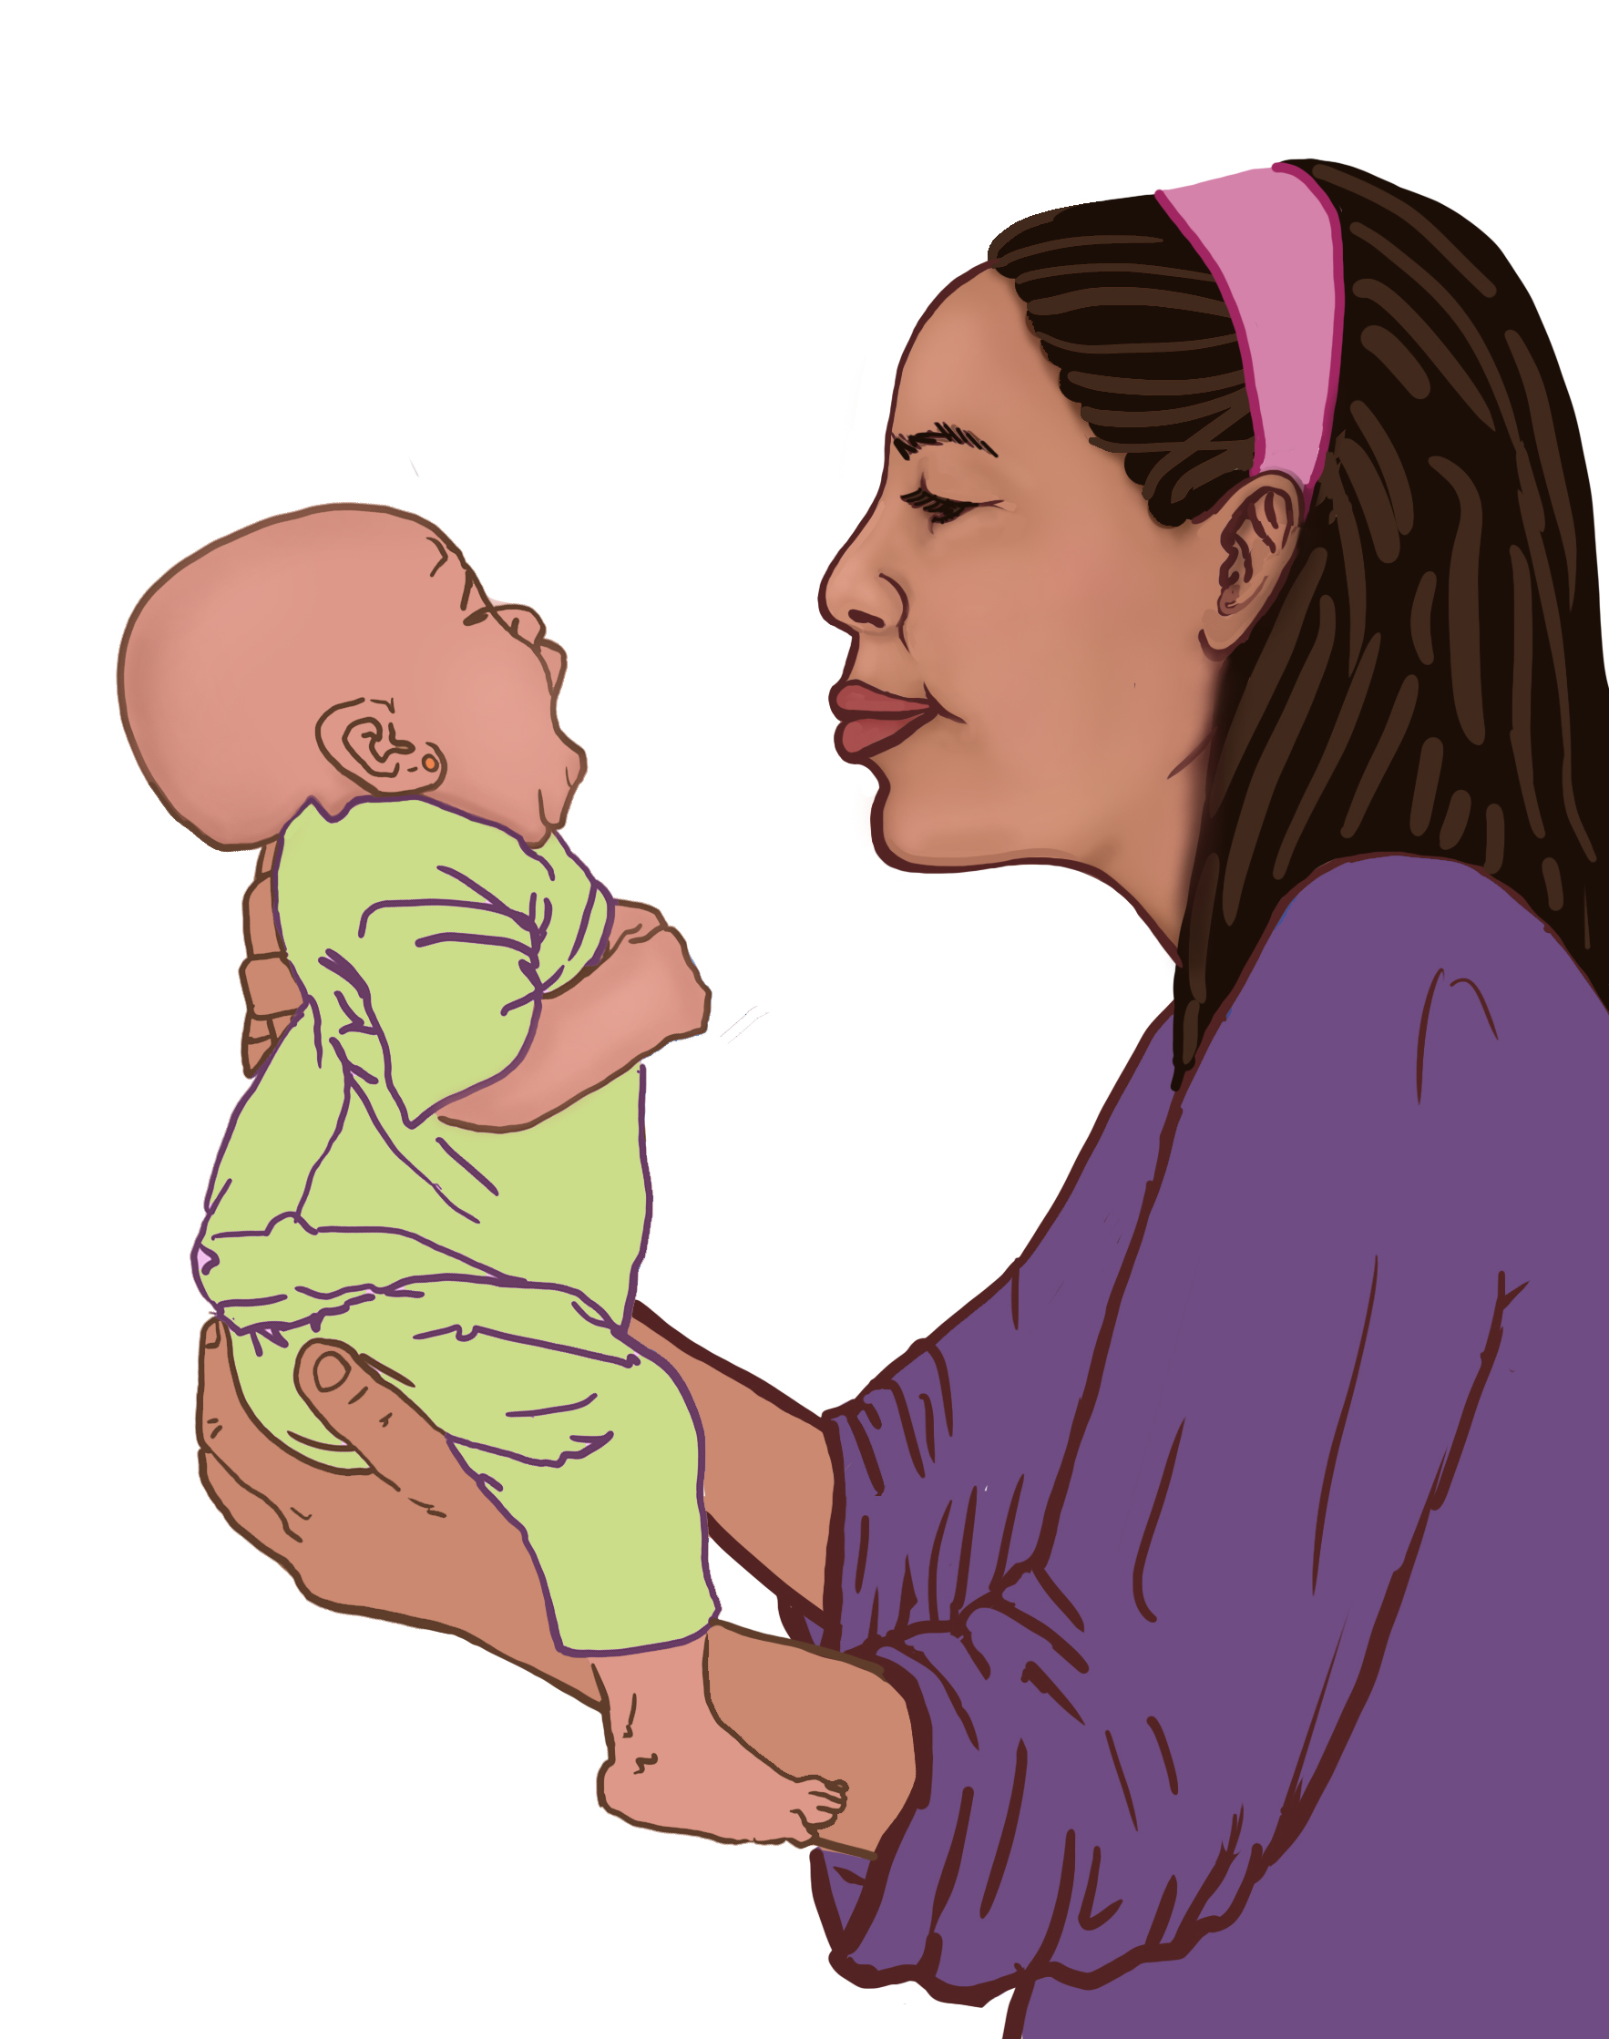
Case #1: Jeanne
Jeanne is a 25-year old G1P1 presenting today for her baby’s vaccines. She is here for her baby, but this is an opportunity to offer Jeanne care as well.
What are Jeanne’s main issues/concerns?
How would you care for Jeanne?
Image source: Jhpiego 2018
Notes:
Notes:
Jeanne could also be a 22-year old G0 presenting for a gynecological complaint or to learn more about family planning. The discussion points would be the same.

Slide 48
Case #1(Jeanne): Discussion
Review/discuss the following:
How old is the infant?
Is Jeanne:
Pregnant?
Birth spacing?
Breastfeeding?
Using family planning methods?
Zika prevention strategies
Notes:
Note:
Whether a visit is for ANC, postpartum, or general health services, try to use the opportunity to address unmet need for family planning counseling and method provision, as applicable.

Slide 49
Case #2: Youseline
Youseline is a 22-year old woman who presents to the clinic with suspicion that she is pregnant and an unknown LMP.
What are Youseline’s main issues/concerns?
How would you care for Youseline?
Image source: Jhpiego 2018

Slide 50
Case #2 (Youseline): Discussion
If Youseline is NOT pregnant, discuss the following:
Does she want to become pregnant?
FP method counseling
Has she had discussions with partner regarding FP?
Has she received information on Zika prevention and recommendations on waiting to become pregnant?
Notes:
Notes:
It is important to establish whether Youseline is pregnant or not then provide care based on the determination.

Slide 51
Case #2 (Youseline): Discussion
If Youseline IS pregnant:
Recommend/schedule ANC contacts per national standards
Discuss Zika risks, transmission, and methods of protection
Begin to discuss FP method choice and document this prior to labor (≤36 weeks)

Slide 52
Case #3: Mariana
Mariana is a 30-year old G3P2 at 20 weeks' gestation presenting for her first antenatal visit. Her visit was prompted by itchy rash and fever. She had been getting care from her midwife.
What are Mariana’s main issues/concerns?
How would you care for Mariana?
Image source: Jhpiego 2018

Slide 53
Case #3 (Mariana): Discussion
Test for Zika infection
Determine gestational age
Consider ordering an ultrasound
Keeping in mind local capacity
Discuss Zika risks, transmission, and methods of protection
Notes:
Notes:
Remember, a rash could be a symptom of Zika infection. So, Mariana should be tested for Zika. An ultrasound is recommended by WHO. If Mariana tests positive for Zika, a repeat ultrasound is recommended at 28 weeks.
*As discussed previously, abnormalities associated with congenital Zika infection may be difficult to detect and depend on the capacity of the ultrasound provider and their equipment. Pregnant women who receive ultrasounds should be counseled on the possible limitations and benefits of ultrasound before and after this service.

Slide 54
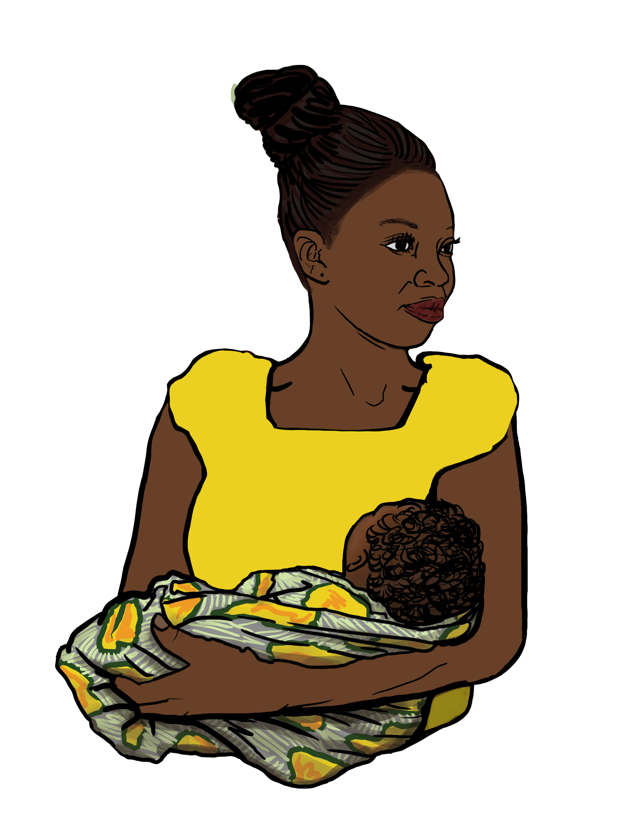
Case #4: Magdalena
Magdalena had a normal pregnancy and vaginal delivery. The baby has a normal physical exam and no apparent anomalies. She received counseling on family planning during her pregnancy but has little recollection of her options now.
What are Magdalena’s main issues/concerns?
How would you care for Magdalena?
Image source: Jhpiego 2018

Slide 55
Case #4 (Magdalena): Discussion
Provide routine postnatal counseling, plus information on Zika prevention
Although baby does not appear to have CZS, babies that appear normal may still develop growth and development abnormalities
Be alert for possible late-appearing complications
Provide information on methods to prevent unplanned pregnancy
Notes:
Notes:
Although Magdalena’s baby does not appear to have CZS, babies that are phenotypically normal may still develop growth and development abnormalities. If a baby was exposed to confirmed Zika infection in utero, care providers should be aware and alert for possible late-appearing complications. It is also important to provide postpartum family planning counseling so Magdalena is aware of her options whether she wants to have more children or wants to prevent an unintended pregnancy.

Slide 56
Module Summary
Follow WHO guidance for pregnant women
Test for Zika if symptoms are present
Consider referral options for pregnant women and infants
Include family planning as a key strategy to promote women's health and combat adverse outcomes of Zika outbreak

Slide 57
Module Resources
CDC Map of Current Areas at Risk
https://wwwnc.cdc.gov/travel/page/world-map-areas-with-zika
WHO Decision Charts for the Care of Pregnant at Risk of Zika Infection
http://www.who.int/csr/resources/publications/zika/pregnancy-management/en/
WHO Medical Eligibility Criteria for Contraceptive Use (MEC) www.who.int/reproductivehealth/publications/family_planning/Ex-Summ-MEC-5/en/
Selected Practice Recommendations (SPR) for Contraceptive Use www.cdc.gov/mmwr/preview/mmwrhtml/rr6205a1.htm
K4 Health Family Planning References and Resources https://www.k4health.org/toolkits/fp-trm/family-planning-references-and-resources

Slide 58
Works Cited
CDC. US Zika Pregnancy Registry outcomes:. Retrieved from https://www.cdc.gov/vitalsigns/zika-babies/ on 11/27/2018
CDC (2017). Zika 101 [PowerPoint slides]. Retrieved from https://www.cdc.gov/zika/comm-resources/ on 11/27/2018.
CDC (2017). Zika Virus: Information for Clinicians [PowerPoint slides]. Retrieved from https://www.cdc.gov/zika/comm-resources/ on 11/27/2018.
Foy BD et al. Probable non–vector-borne transmission of Zika virus, Colorado, USA. Emerg Infect Dis, 2011 May, http://dx.doi.org/10.3201/eid1705.101939)
Johansson MA, Mier-Y-Teran-Romero L, Reefhuis J, Gilboa SM, Hills SL. Zika and the Risk of Microcephaly. N Engl J Med. 2016 Jul 7;375(1):1-4. doi: 10.1056/NEJMp1605367. Epub 2016 May 25.
Linden V, Pessoa A, Dobyns WB, et al. Description of 13 Infants Born During October 2015–January 2016. MMWR. 22 Nov 2016.
Mead PS et al. Zika Virus Shedding in Semen of Symptomatic Infected Men. N Engl J Med 2018;378:1377-85. DOI: 10.1056/NEJMoa1711038
WHO. WHO Director-General summarizes the outcome of the Emergency Committee regarding clusters of microcephaly and Guillain-Barré syndrome. 2016. Retrieved on 11/27/2018 from http://www.who.int/mediacentre/news/statements/2016/emergency-committee-zika-microcephaly/en/

Slide 59
Acknowledgements
MCSP is a global USAID program to introduce and support high-impact health interventions in 25 priority countries to help prevent child and maternal deaths. MCSP supports programming in maternal, newborn, and child health, immunization, family planning and reproductive health, nutrition, health systems strengthening, water/sanitation/hygiene, malaria, prevention of mother-to-child transmission of HIV, and pediatric HIV care and treatment. MCSP will tackle these issues through approaches that also focus on household and community mobilization, gender integration, and digital health, among others.
This learning module is made possible by the generous support of the American people through the United States Agency for International Development (USAID) under the terms of the Cooperative Agreement AID-OAA-A-14-00028. The contents are the responsibility of the Maternal and Child Survival Program and do not necessarily reflect the views of USAID or the United States Government.

