Slide 1
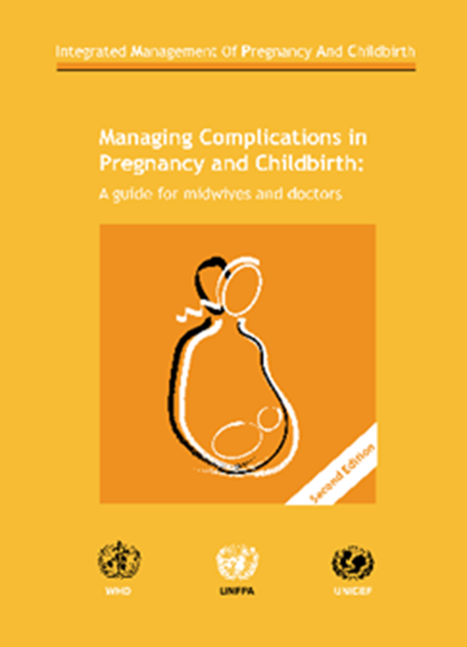
WHO’s “Managing Complications in Pregnancy and Childbirth” (MCPC): What’s New in the Second Edition?
December 2018

Slide 2
Presentation Outline
Dissemination of the 2nd edition MCPC
MCPC background and overview of revision process
Review of updates on:
Respectful maternity care (RMC) for mother and newborn
Pre-eclampsia/eclampsia (PE/E)
Bleeding in early pregnancy and postpartum haemorrhage (PPH)
Immediate newborn problems
Prevention and management of infection in pregnancy and childbirth

Slide 3
Global Dissemination of MCPC
Manual
WHO printed 2,000 copies (English) in November 2017
Planning French translation; possibly Spanish
Briefers
English, French, Spanish and Portuguese
Technical PPT (WHO/MCSP)
Dissemination at country, regional and global Meetings

Slide 4
MCPC Background
Reference manual for midwives and doctors working at district hospital level
Uses symptom/sign-based, step-by-step approach (e.g., vaginal bleeding in early pregnancy)
Section 1: Clinical principles
Section 2: Symptoms
Section 3: Procedures
First edition published in 2000 (reprinted 2007)

Slide 5
MCPC Revision Process
User survey conducted in 2015 to solicit stakeholder feedback to inform revisions
Core team of WHO, partners and external experts prioritized 18 chapters for revision
WHO and MCSP members assigned as technical co-leads for each chapter targeted for revision
Revisions had to be consistent with previously updated WHO guidelines and recommendations
WHO Guideline Review Committee (GRC) requirement: two expert external reviewers for each revised chapter
Every revision tracked in master list of 2nd edition MCPC changes

Slide 6
18 MCPC Chapters Prioritized for Revision
Chapter Category | First Edition Chapters Revised
Clinical Principles (Section 1) | Emotional and psychological support Emergencies General care principles Antibiotic therapy Operative care principles Normal labour and childbirth Newborn care principles
Symptoms (Section 2) | Vaginal bleeding in early pregnancy Vaginal bleeding after childbirth Elevated blood pressure, headache, blurred vision, convulsions or loss of consciousness Fever during pregnancy and labour Fever after childbirth Difficulty in breathing Prelabour rupture of membranes Immediate newborn conditions or problems
Procedures (Section 3) | Induction and augmentation of labour Manual removal of placenta Repair of vaginal and perineal tears

Slide 7
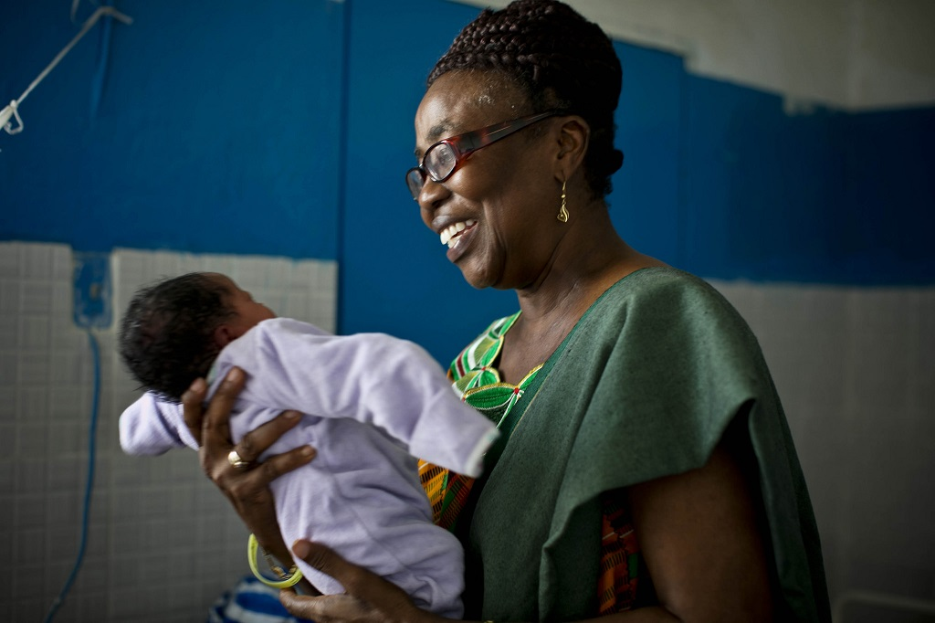
Revisions Related to Respectful Maternity Care (RMC) for Mothers and Newborns
Photo by Kate Holt, Liberia

Slide 8
18 Updated MCPC Priority Chapters
Chapter Category | First Edition Chapters Revised
Clinical Principles (Section 1) | Emotional and psychological support Emergencies General care principles Antibiotic therapy Operative care principles Normal labour and childbirth Newborn care principles
Symptoms (Section 2) | Vaginal bleeding in early pregnancy Vaginal bleeding after childbirth Elevated blood pressure, headache, blurred vision, convulsions or loss of consciousness Fever during pregnancy and labour Fever after childbirth Difficulty in breathing Prelabour rupture of membranes Immediate newborn conditions or problems
Procedures (Section 3) | Induction and augmentation of labour Manual removal of placenta Repair of vaginal and perineal tears

Slide 9
Respectful Maternity Care (RMC) for Mothers and Newborns
RMC is recognized as a universal right of all women and newborns and an essential component of quality care.
The MCPC updates reflect this importance.
Emotional and Psychological Support chapter offers guidance on meeting women’s and families’ emotional and psychosocial needs in emergencies, emphasizing the importance of clear, honest communication and empathy.

Slide 10
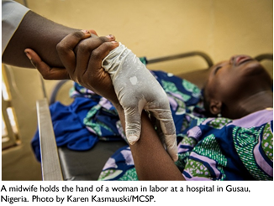
Respectful Maternity Care: Basic Care Principles
To reinforce RMC as a key element of quality care, many updated chapters refer readers to the care principles outlined in revised General Care Principles chapter:
Where feasible, ensure that the woman has a companion of her choice with her.
Provide information to the woman—and any accompanying family members the woman would like to be involved in decision-making—about the care to be provided and what to expect.
Obtain Informed consent for all procedures, including diagnostic and treatment interventions

Slide 11
Revisions Related to Pre-Eclampsia and Eclampsia (PE/E)
Revised chapter reflects WHO 2011 Recommendations for Prevention and Treatment of Pre-eclampsia and Eclampsia

Slide 12
18 Updated MCPC Priority Chapters
Chapter Category | First Edition Chapters Revised
Clinical Principles (Section 1) | Emotional and psychological support Emergencies General care principles Antibiotic therapy Operative care principles Normal labour and childbirth Newborn care principles
Symptoms (Section 2) | Vaginal bleeding in early pregnancy Vaginal bleeding after childbirth Elevated blood pressure, headache, blurred vision, convulsions or loss of consciousness Fever during pregnancy and labour Fever after childbirth Difficulty in breathing Prelabour rupture of membranes Immediate newborn conditions or problems
Procedures (Section 3) | Induction and augmentation of labour Manual removal of placenta Repair of vaginal and perineal tears

Slide 13
PE/E: Key Areas of Revision
Revised classification framework for hypertensive disorders of pregnancy, including PE/E
Prevention of PE/E
Calcium supplementation
Low-dose aspirin
Use of systolic blood pressure (SBP) in diagnosis and management of PE/E
Use of laboratory findings for PE/E diagnosis and management
Use of antihypertensive medication for management of hypertension (HTN), including acute severe systolic HTN
Anticonvulsant therapy for severe PE/E
Timing of delivery in women with severe PE and eclampsia
Postpartum monitoring
Specialized postpartum care and follow-up

Slide 14
Revised Classification Framework for Hypertensive Disorders in Pregnancy, including PE/E
Chronic hypertension (elevation of BP < 20 weeks gestation or persisting > 12 weeks postpartum)
Gestational hypertension (onset of HTN in pregnancy without pre-eclampsia)
(Mild) pre-eclampsia
Severe pre-eclampsia
Eclampsia
Chronic hypertension with superimposed pre-eclampsia

Slide 15
PE/E Prevention
Calcium supplementation (in areas with low dietary intake)
1.5–2.0 g elemental calcium/day
All women, but particularly those at high risk for PE*
Low-dose (75 mg) acetylsalicylic acid (aspirin)
Initiated at 12‒20 weeks of gestation for women at high risk for PE*
*Risk Factors for Developing PE/E:
Previous severe PE/E, diabetes, chronic hypertension, obesity, renal disease, autoimmune disease and multiple pregnancies

Slide 16
Clinical Criteria for Diagnosis of Hypertension in Pregnancy
Systolic blood pressure (SBP) > 140 mm Hg and/or diastolic blood pressure (DBP) > 90 mm Hg (two consecutive readings 4 hours or more apart)
Severe SBP > 160 and/or DBP > 110 mm Hg

Slide 17
PE: Diagnosis, Monitoring and Timing of Childbirth
Diagnosis of (mild) pre-eclampsia
Monitoring and timing of childbirth for (mild) pre-eclampsia
New onset hypertension and proteinuria after 20 weeks of gestation:
Proteinuria 2+ on dipstick
No severe features of PE/E present (see next slide for severe features)
Gestational age less than 37 + 0/7 weeks
As long as mother and fetal well-being remain stable, the goal is for the woman to reach 37 + 0/7 weeks before childbirth.
However, remain vigilant because pre-eclampsia may rapidly progress to severe pre-eclampsia at any time
Monitor the status of the woman and fetus closely. Regularly measure the woman’s blood pressure and assess for danger signs.
Outpatient care: If blood pressure and signs of pre-eclampsia normalize or remain unchanged, follow up twice per week.
If outpatient follow-up is not possible, admit the woman for close monitoring, including blood pressure and danger signs.
Induce labour/childbirth
Systolic blood pressure > 140 and/or diastolic blood pressure > 90 after 20 weeks of gestation
Gestational age greater than or equal to 37 + 0/7 weeks

Slide 18
Severe PE: Diagnosis and Timing of Childbirth
Diagnosis of severe pre-eclampsia
Monitoring and timing of childbirth for severe pre-eclampsia
New onset hypertension and proteinuria after 20 weeks of gestation:
Systolic blood pressure > 160 and/or diastolic blood pressure > 110 after 20 weeks of gestation
Gestational age less than 24 weeks (previable fetus)
Magnesium sulfate (MgSO4), antihypertensive medications
MgSO4, antihypertensive medications
Same management as for 24‒34 weeks except NO antenatal corticosteroids
MgSO4, antihypertensive medications; expedite delivery
Gestational age of 37 + 0/7 weeks
Induce labour
Gestational age of 24‒34 weeks
Close maternal and fetal monitoring; expedite birth if maternal and fetus status not stable
Gestational age of 34‒36 6/7 weeks
Proteinuria 2+ on dipstick
Pre-eclampsia with any of the following present should be diagnosed as severe pre-eclampsia:
Neurologic: headache, vision changes, hyperreflexia or clonus
Pulmonary: difficulty breathing (rales on auscultation due to fluid in lungs)
Hepatic: upper abdominal pain, nausea/vomiting or liver enzymes elevated (greater than two times the baseline)
Renal: serum creatinine > 1.1mg/dL or doubling of baseline, oliguria (< 400 cc urine in 24 hours)
Hematologic: platelets less than 100,000 cells/mcL
Antenatal corticosteroids to promote fetal lung maturity if WHO safety criteria met

Slide 19
Anticonvulsive Treatment for PE/E
Magnesium sulfate—anticonvulsant of choice
Diazepam removed as a treatment option for PE/E

Slide 20
Magnesium Sulfate Regimens for Severe PE/E
Route | Loading dose | Maintenance dose
Intramuscular (IM) Regimen
IV and IM | (IV and IM) Give 4 g of 20% MgSO4 solution IV over 5 minutes. Follow promptly with 10 g of 50% MgSO4 solution IM: Give 5 g in each buttock as a deep IM injection with 1 mL of 2% lidocaine in the same syringe. If convulsions recur after 15 minutes, give 2 g of 50% MgSO4 solution IV over five minutes. | (IM) Give 5 g of 50% MgSO4 solution with 1 mL of 2% lidocaine in the same syringe by deep IM injection into alternate buttocks every 4 hours. Continue treatment for 24 hours after birth or the last convulsion, whichever occurs last.
Intravenous (IV) Regimen (New in 2nd Edition)
IV | Give 4 g of 20% MgSO4 solution IV over 5 minutes If convulsions recur after 15 minutes, give 2 g of 50% MgSO4 solution IV over five minutes. | Give intravenous infusion 1g/ hr. Continue treatment for 24 hours after childbirth or the last convulsion, whichever occurs last.

Slide 21
Antihypertensive Treatment of Stable Elevated Blood Pressure in Pregnancy
*Note: Women with CHF, hypovolemic shock, or asthma should not receive labetalol.
Antihypertensive Option | Dosing
Alpha methyldopa | 250 mg every 6-8 hours Maximum dose 2000 mg/24 hours
Nifedipine (immediate release capsules) | 10-20 mg every 12 hours Maximum dose 120 mg/24 hours
Labetalol* | 200 mg every 6-12 hrs Maximum dose 1200 mg/24 hours

Slide 22
Treatment of Acute Severe Hypertension in Pregnancy: SBP > 160 mm Hg and/or DBP > 110 mm Hg
Antihypertensive options | Dosing
Hydralazine | Intravenous treatment: Administer 5 mg IV, slowly (risk of maternal hypotension; closely monitor blood pressure). Repeat every five minutes until the blood pressure goal has been achieved. Repeat hourly as needed or give 12.5 mg IM every two hours as needed. The maximum dose is 20 mg per 24 hours.
Labetalol | Oral treatment: Administer 200 mg. Repeat dose after one hour until the treatment goal is achieved. The maximum dose is 1200 mg in 24 hours. Intravenous treatment: Administer 10 mg IV. If response is inadequate after 10 minutes, administer 20 mg IV. The dose can be doubled to 40 mg and then 80 mg with 10-minute intervals between each increased dose until blood pressure goal is lowered below threshold. The maximum total dose is 300 mg; then switch to oral treatment.
Nifedipine (immediate-release capsule) | Oral treatment: Administer 5–10 mg orally. Repeat dose after 30 minutes if response is inadequate, until optimal blood pressure is reached. The maximum total dose is 30 mg in the acute treatment setting.ª
Alpha methyldopa | Oral treatment: Administer 750 mg orally. Repeat dose after three hours until blood pressure goal is achieved. The maximum dose is 3 grams in a 24-hour period.

Slide 23
New Section on Postpartum Care for Women with PE/E
Counsel regarding increased lifetime risk of cardiovascular disease (CVD)
Assess and address risk factors for CVD (e.g., smoking, obesity, chronic hypertension, lack of physical activity, hyperlipidaemia) before discharge
Link to follow-up and ongoing care for monitoring of blood pressure and CVD risk factors
Counsel regarding risk of PE/E with future pregnancies, importance of preventing unwanted pregnancy, and importance of early ANC enrolment in future pregnancies
Provide effective, appropriate family planning (FP) method of choice (e.g., long-acting reversible contraceptives)

Slide 24
Revisions Related to Obstetric Haemorrhage: Bleeding in Early Pregnancy and Postpartum Haemorrhage (PPH)

Slide 25
18 Updated MCPC Priority Chapters
Chapter Category | First Edition Chapters Revised
Clinical Principles (Section 1) | Emotional and psychological support Emergencies General care principles Antibiotic therapy Operative care principles Normal labour and childbirth Newborn care principles
Symptoms (Section 2) | Vaginal bleeding in early pregnancy Vaginal bleeding after childbirth Elevated blood pressure, headache, blurred vision, convulsions or loss of consciousness Fever during pregnancy and labour Fever after childbirth Difficulty in breathing Prelabour rupture of membranes Immediate newborn conditions or problem
Procedures (Section 3) | Induction and augmentation of labour Manual removal of placenta Repair of vaginal and perineal tears

Slide 26
Bleeding in Early Pregnancy
Updates to differential diagnosis and management of threatened, inevitable and incomplete abortion, ectopic pregnancy, and molar pregnancy
Updated guidance on management of inevitable and incomplete abortion, including surgical, medical and expectant management options; new table summarizing medical management drugs and protocol
Updated section on management of abortion-related infection/sepsis: clindamycin and ampicillin as first-line drugs; gentamycin and ampicillin as second-line drugs; both regimens without metronidazole
Updated guidance on postabortion counselling and immediate initiation of contraception after an abortion

Slide 27
Definition and Classification of Postpartum Haemorrhage (PPH)
Definition
PPH is commonly defined as blood loss in excess of 500 mL
Severe PPH is defined as blood loss of 1000 mL or more or change in vital signs with any blood loss
Classification of PPH
Increased vaginal bleeding within the first 24 hours after childbirth is primary PPH
Increased vaginal bleeding following the first 24 hours after childbirth is secondary PPH (delayed PPH)
Notes:
Say, L et al. ”Global causes of maternal death: a WHO systematic analysis.” The Lancet Global Health 2014; Volume 2, Issue 6: e323‒e333.

Slide 28
Active Management of Third Stage of Labour (AMTSL)
The main component of active management of the third stage of labour is immediate postpartum uterotonic medication.
Oxytocin is preferred because it is effective 2 to 3 minutes after injection, has minimal side effects and can be used in all women.
If oxytocin, if not available give:
Oral misoprostol 600 mcg; or
Ergometrine (0.2mg IM) or methylergometrine; or
Fixed drug combination of oxytocin and ergometrine.
Placenta may be allowed to deliver physiologically (controlled cord traction is contraindicated in settings without a skilled birth attendant).

Slide 29
Postpartum Monitoring of Uterine Tone for Early Recognition of Uterine Atony
Regular postpartum assessment of uterine tone is recommended for all women.
Sustained uterine massage is not recommended for PPH prevention in women who have received a uterotonic.

Slide 30
Atonic Uterus
The following subsections are new:
Uterine Massage and Medicines
Bimanual Uterine Compression
External Aortic Compression
Intrauterine Balloon Tamponade
Surgical Interventions in the Treatment of PPH
Uterine Compression Suture (B-lynch)

Slide 31
Use of Medicines in Management of PPH
 | Dose and route* | Continuing dose* | Maximum dose | Precautions and contraindications
Oxytocin | IV: infuse 20 units in 1 L at fastest flow rate possible IM: 10 units | IV: infuse 20 units in 1 L fluids at 40 drops per minute | Not more than 3 L of intravenous fluids containing oxytocin | Do not give as an IV bolus
Ergometrine/ methylergometrine | IM or IV (slowly): 0.2 mg | Repeat 0.2 mg IM; after 15 minutes If required, give 0.2mg IM or IV (slowly) every four hours | Five doses (total 1.0 mg) | High blood pressure, pre-eclampsia, heart disease, retained placenta
15-methyl prostaglandin F2 alpha | IM: 0.25 mg | 0.25 mg every 15 minutes | Eight doses (total 2 mg) | Asthma Do not give IV
Misoprostol (new in second edition) | Sublingual: 800 mcg | Repeat 200–800 mcg | Not more than 1600mcg
Tranexamic acid (new in second edition) | IV (slowly): 1 g | Repeat after 30 minutes if bleeding continues | Not more than 10 mg per kg of body weight; three to four times daily | History of coagulopathy or active intravascular clotting, convulsions

Slide 32
Uterine Balloon Tamponade (UBT)
If bleeding continues in spite of bimanual and aortic compression, insert uterine balloon tamponade
Inflate to 300‒500 mL
Administer Ampicillin 2 g IV (or cefazolin 1 g IV) before the procedure
Keep in place for 6‒24 hours and slowly deflate the balloon monitoring closely for bleeding
If bleeding continues, consider surgical interventions
Uterine balloon tamponade graphic added (see next slide; from Jhpiego job aid)

Slide 33
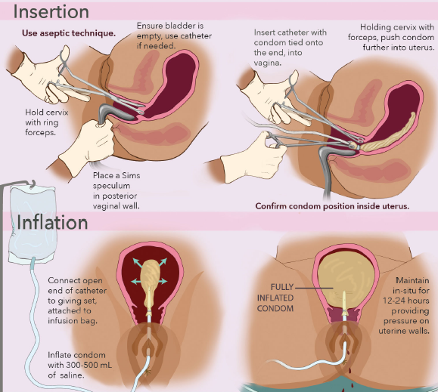

Slide 34
Non-Pneumatic Anti-Shock Garment
Newly included in MCPC as temporizing measure for PPH
Guidance on application and removal

Slide 35
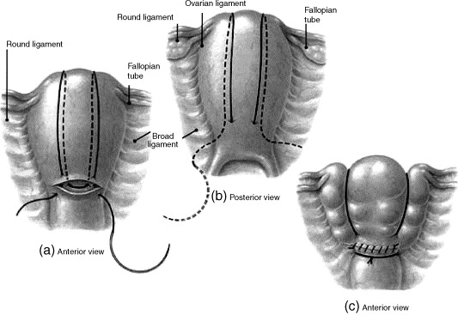
Surgical Interventions in Management of PPH
Uterine compression suture (B-Lynch)
If bleeding does not stop, further surgical intervention (subtotal or total hysterectomy) is required.
World Health Organization, Managing Complications in Pregnancy and Childbirth. Geneva: WHO, 2017; figure S-7.

Slide 36
Vaginal and Perineal Tears
Single oral dose of prophylactic antibiotic (ampicillin 500 mg) should be administered before beginning repair of third and fourth degree tears (but not first and second degree tears).

Slide 37
Retained Placenta with Bleeding
Manual removal of the placenta should be attempted after administration of a prophylactic antibiotic (single dose, ampicillin 2 gm IV or cefazolin1gm IV).

Slide 38
Care after PPH
Updated guidance on postpartum care, including: counselling on self-care, nutrition, iron supplementation, postpartum family planning, warning signs/care-seeking

Slide 39
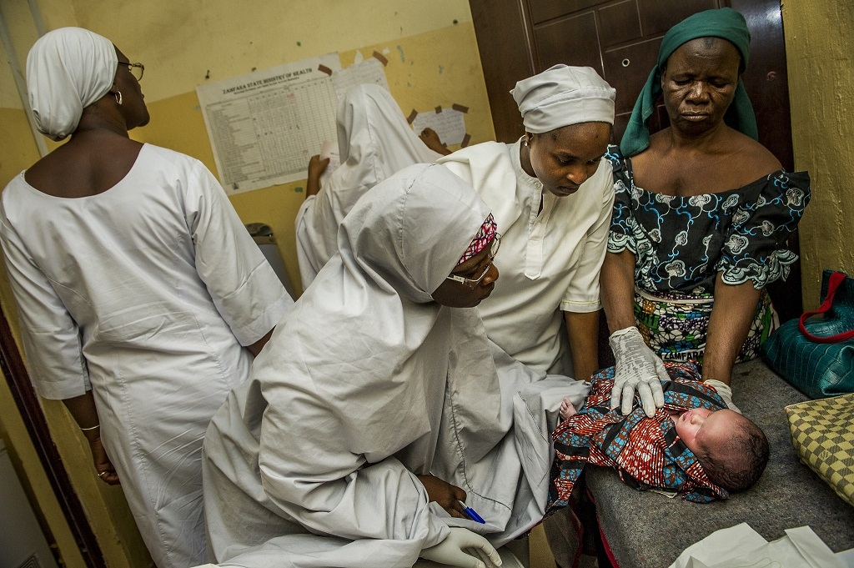
Revisions Related to
Immediate Newborn Problems
Photo by Karen Kasmauski, Nigeria

Slide 40
Immediate Newborn Conditions or Problems
Chapter Category | First Edition Chapters Revised
Clinical Principles (Section 1) | Emotional and psychological support Emergencies General care principles Antibiotic therapy Operative care principles Normal labour and childbirth Newborn care principles
Symptoms (Section 2) | Vaginal bleeding in early pregnancy Vaginal bleeding after childbirth Elevated blood pressure, headache, blurred vision, convulsions or loss of consciousness Fever during pregnancy and labour Fever after childbirth Difficulty in breathing Prelabour rupture of membranes Immediate newborn conditions or problems
Procedures (Section 3) | Induction and augmentation of labour Manual removal of placenta Repair of vaginal and perineal tears

Slide 41
Immediate Recognition and Management of Signs of Serious Illness in a Newborn
Signs of serious illness in a newborn expanded in 2nd edition (e.g., lethargy, movement only when stimulated, hyperthermia in addition to hypothermia)
Also updated initial antibiotic treatment and communication with family of newborn:
Administer first dose of ampicillin (50 mg/kg body weight) and gentamycin (5 mg/kg body weight) IM for signs of serious illness; refer without delay.
Inform mother and companion/family about what is happening and keep them updated as care is given.

Slide 42
Management of Breathing Difficulty
Drying, additional stimulation, and ventilation (if needed) in first minute
Suctioning only if amniotic fluid is meconium-stained or mouth/nose is full of secretions (no routine suctioning)
Resuscitation illustrations added and revised (new graphic demonstrating correct fit of mask; use of size 0 for small infants < 2.5 kg)
Added guidance on continuous positive airway pressure (CPAP) and safe use of oxygen in neonate (delivery method/nasal prongs; safe oxygen limit; risks)

Slide 43
New Section: Management of Asymptomatic Newborns Exposed to Infection
Treat with prophylactic antibiotics—ampicillin and gentamycin IM—for at least 2 days while infection is ruled out.
Key indications for prophylactic antibiotics:
Preterm prelabour rupture of membranes
Membranes ruptured > 18 hours before birth
Mother is being treated with antibiotics for chorioamnionitis
Mother had fever greater than 38ºC before childbirth or during labour
Amniotic fluid was foul-smelling or purulent
Mother had Group B streptococcus colonization without adequate antibiotic therapy during labour

Slide 44
Early Management of Low Birth Weight Newborns
Low birthweight (LBW)/prematurity categories expanded to include:
LBW (< 2500 gm), moderate to late preterm (32‒36 weeks plus 6 days)
Very LBW (< 1500 gm) or very preterm (< 32 weeks)
Addition of kangaroo mother care: early continuous and prolonged skin-to-skin and exclusive breastfeeding or feeding with breastmilk
Transfer of very LBW or very preterm infants for specialized care
Safe oxygen and antibiotic use in LBW infants

Slide 45
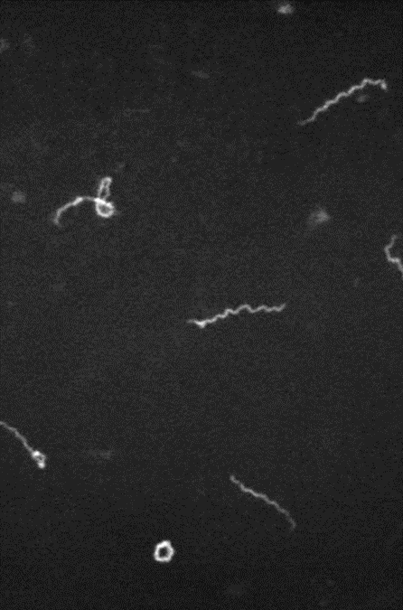
Revisions Related to Prevention and Management of Infection in Pregnancy and Childbirth

Slide 46
18 Updated MCPC Priority Chapters
Chapter Category | First Edition Chapters Revised
Clinical Principles (Section 1) | Emotional and psychological support Emergencies General care principles Antibiotic therapy Operative care principles Normal labour and childbirth Newborn care principles
Symptoms (Section 2) | Vaginal bleeding in early pregnancy Vaginal bleeding after childbirth Elevated blood pressure, headache, blurred vision, convulsions or loss of consciousness Fever during pregnancy and labour Fever after childbirth Difficulty in breathing Prelabour rupture of membranes Immediate newborn conditions or problems
Procedures (Section 3) | Induction and augmentation of labour Manual removal of placenta Repair of vaginal and perineal tears

Slide 47
Prevention and Management of Infection in Pregnancy and Childbirth
Revisions incorporate:
Antibiotic therapy (key principles)
WHO’s 2015 Global Recommendations for Prevention and Treatment of Maternal Peripartum Infections
Updated summary tables of clinical presentation of common infections in pregnancy and after childbirth
Revised antibiotic treatment recommendations for several infections
Updated section on management of malaria in pregnant women based on WHO’s 2015 Guidelines for the Treatment of Malaria

Slide 48
Prevention and Management of Infection in Pregnancy and Childbirth (cont.)
Antibiotic therapy principles:
Appropriate and inappropriate use of antibiotics for infection prevention and treatment
Judicious use of antibiotics to reduce antimicrobial resistance (narrow spectrum antibiotic, correct dosing and duration)
Monitoring local bacteria, antibiotic susceptibility and resistance patterns to inform antibiotic selection, where feasible
Avoiding and managing antibiotic allergies, including anaphylaxis

Slide 49
When Prophylactic Antibiotics Are Not Recommended
Prophylactic antibiotics are not recommended under these conditions:
Uncomplicated vaginal birth
Operative vaginal birth
Episiotomy
First- or second-degree lacerations

Slide 50
Indications for Prophylactic Antibiotics
Obstetrical procedure or condition | Recommended antibiotic(s) and dosage
Caesarean section (elective and emergency) Administer before the procedure, not after clamping and cutting the cord New recommendation for cleansing the vagina with povidone-iodine before a caesarean Manual removal of placenta Placement of uterine balloon tamponade | Single dose of antibiotics (ampicillin or first-generation cephalosporin): Ampicillin 2 g IV; OR Cefazolin 1 g IV
Repair of third and fourth degree lacerations | Single dose of antibiotic: Ampicillin 500 mg
Preterm prelabour rupture of membranes (PPROM) | Oral erythromycin 250 mg every 6 hours for 10 days (or until birth); or Ampicillin 2 g IV every 6 hours

Slide 51
Updated Timing of Pre-Procedure Antibiotic Prophylaxis
NEW
Whenever possible, give prophylactic IV antibiotic 15‒60 minutes before start of procedure to achieve adequate blood levels of antibiotic at time of procedure.
Obstetric procedures for which antibiotic prophylaxis is recommended:
Elective and emergency caesarean (note: prophylaxis given before incision whenever possible);
suturing of third and fourth degree tears;
Manual removal of placenta;
Placement of uterine balloon tamponade.

Slide 52
Differential Diagnosis of Fever during Pregnancy and Labour
Typical signs and symptoms (in addition to fever, chills) | Possible diagnoses
Dysuria, frequency; flank pain | Cystitis; pyelonephritis
Foul-smelling discharge, lower abdominal pain, uterine tenderness, maternal tachycardia, fetal tachycardia | Septic abortion; amnionitis
Headache, muscle/joint pain, anaemia, coma; sometimes convulsions, jaundice | Uncomplicated malaria; severe malaria
Cough with expectoration, chest pain; sometimes rapid/difficulty breathing, rhonchi/rales on pulmonary exam | Pneumonia
Dry cough, malaise, anorexia; sometimes confusion/stupor | Typhoid
Malaise, anorexia, nausea, dark urine/pale stool, jaundice | Hepatitis

Slide 53
Differential Diagnosis of Fever after Childbirth
Typical signs and symptoms (in addition to fever, chills) | Possible diagnoses
Lower abdominal pain; purulent, foul-smelling lochia; uterine tenderness; persistent spiking fever/chills despite antibiotics | Postpartum endometritis; pelvic abscess; peritonitis
Breast pain and tenderness | Mastitis; breast abscess
Unusually tender wound | Wound seroma, haematoma, cellulitis, or abscess
Dysuria, frequency; flank pain | Cystitis; acute pyelonephritis
Spiking fever despite antibiotics, leg swelling, tenderness, redness | Deep vein thrombosis
Pleuritic chest pain, shortness of breath, tachypnea, hypoxia | Pre-eclampsia, pneumonia
Cough with expectoration, chest pain; sometimes rapid/difficulty breathing, rhonchi/rales on pulmonary exam | Pneumonia
Headache, muscle/joint pain, anaemia, coma; sometimes convulsions, jaundice | Uncomplicated malaria; severe malaria
Dry cough, malaise, anorexia; sometimes confusion/stupor | Typhoid
Malaise, anorexia, nausea, dark urine/pale stool, jaundice | Hepatitis

Slide 54
Therapeutic Antibiotics for Selected Infections in Pregnant and Postpartum Women
Diagnosis | New in second edition | Comments
Cystitis | Antibiotic options and dosing of either amoxicillin or nitrofurantoin remain the same, except: Avoid nitrofurantoin at term as it can cause neonatal haemolysis Do not use trimetoprim/ sulfamethoxazole due to interference with folic acid metabolism and increased risk of congenital malformations | Amoxicillin 500 mg by mouth every 8 hours for 3 days; or nitrofurantoin 100 mg by mouth every 8 hours for 3 days
Acute pyelonephritis | Antibiotic regimen IV ampicillin PLUS gentamicin followed by oral amoxicillin remains the same Added emphasis on prompt identification and treatment of pyelonephritis in pregnancy to prevent significant illness Importance of re-evaluating diagnosis and choice of antibiotic if there is no clinical response in 48 hours. | Ampicillin 2 g intravenously (IV) every 6 hours PLUS gentamicin 5 mg IV per kg of body weight every 24 hours; amoxicillin 1 g orally every 8 hours to complete 14 days of treatment

Slide 55
Therapeutic Antibiotics for Specific Infections in Pregnant and Postpartum Women (cont.)
Diagnosis | New in second edition | Comments
Amnionitis | Antibiotic regimen IV ampicillin PLUS gentamicin remains the same If the woman gives birth vaginally, new guidance to continue treatment for at least 48 hours after the symptoms and signs of infection have subsided. | Ampicillin 2 g IV every 6 hours PLUS gentamicin 5 mg IV per kg of body weight every 24 hours
Postpartum endometritis | Antibiotic regimen changed from ampicillin, gentamicin and metronidazole to clindamycin and gentamicin for 24–48 hours after complete resolution of clinical signs and symptoms (fever, uterine tenderness, purulent lochia, leukocytosis). Oral antibiotics are not necessary following IV antibiotics. | Clindamycin 600 mg IV every 8 hours PLUS gentamicin 5 mg IV per kg of body weight every 24 hours If clindamycin is not available: Ampicillin 2 g IV every 6 hours PLUS gentamicin 5 mg/kg body weight IV every 24 hours When available, clindamycin (in combination with gentamycin) is more effective than ampicillin or a penicillin antibiotic for the treatment of postpartum endometritis.

Slide 56
Therapeutic Antibiotics for Specific Infections in Pregnant and Postpartum Women (cont.)
Diagnosis | New in second edition | Comments
Serious infections of pelvic organs | Antibiotic regimen narrowed to IV ampicillin PLUS gentamicin, with no metronidazole. Discontinue antibiotics 48 hours after complete resolution of clinical signs and symptoms. | Ampicillin 2 g IV every six hours PLUS gentamicin 5 mg IV per kg of body weight every 24 hours
Pelvic abscess, peritonitis | Antibiotic regimen remains the same: IV ampicillin PLUS gentamicin, PLUS metronidazole. | Ampicillin 2 g IV every six hours PLUS gentamicin 5 mg IV per kg body weight every 24 hours PLUS metronidazole 500 mg IV every eight hours
Mastitis or breast abscess | Antibiotic regimen remains the same: oral cloxacillin or erythromycin for 10 days. | Cloxacillin 500 mg by mouth every 6 hours or erythromycin 250 mg every 8 hours For abscess, surgical drainage is an option as well.

Slide 57
If Infection Suspected as Cause of Shock
UPDATED ANTIBIOTIC TREATMENT RECOMMENDATION
Collect appropriate samples (blood, urine, pus) for microbial culture, if facilities available, before starting antibiotics. Give combination of two antibiotics to cover aerobic + anaerobic infections, and continue until fever-free for 48 hours: AMPICILLIN 2 g IV q 6 hours; PLUS GENTAMICIN 5 mg/kg body weight IV q 24 hours Metronidazole no longer recommended as third line antibiotic for treatment of shock in 2nd edition MCPC

Slide 58
Postabortion Infection
First-line regimen
Clindamycin 600 mg IV every 6‒8 hours PLUS
Gentamicin 5 mg/kg body weight IV every 24 hours
Second-line regimen (if clindamycin not available)
Ampicillin 2 g IV every 6 hours PLUS
Gentamicin 5 mg/kg body weight IV every 24 hours

Slide 59
Severe Malaria: Antimalarial Treatment
NEW TREATMENT GUIDELINES
Give parenteral treatment to pregnant women with severe malaria as soon as possible. Mortality for untreated severe malaria (especially cerebral) approaches 100%. With prompt, effective treatment and supportive care, mortality falls to 10–20%. Parenteral artesunate is treatment of choice for severe malaria in all trimesters ARTESUNATE Begin with IV or IM route for at least 24 hours and until woman can tolerate oral medication; then complete oral treatment. If artesunate not available, give IM artemether (or IV quinine if artemether not available) Loading Dose: Give Artesunate 2.4 mg/kg body weight IV every 12 hours for at least 24 hours and until woman can tolerate oral medication. Maintenance Dosing: Artesunate 1.2 mg/kg body weight IV single bolus once daily beginning on second day of treatment. Continue maintenance dosing until woman is conscious and able to swallow oral medication. Then give oral artesunate 2 mg/kg body weight once daily for a total of 7 days of treatment.

Slide 60
Syphilis in Pregnancy
Syphilis in pregnancy can lead to adverse perinatal outcomes including:
Early fetal loss, stillbirth, neonatal death, prematurity, low birth weight, and evidence of syphilis in neonate
To prevent maternal-to-child transmission:
Screen all pregnant women and partners at first antenatal care visit (preferably before 16 weeks) and again in late pregnancy. Treat as indicated.
If not screened during pregnancy, screen women during labour or immediately postpartum, before discharge.

Slide 61
Syphilis in Pregnancy
UPDATED RECOMMENDATIONS
Treatment of baby exposed to syphilis in utero: If mother has positive serologic test or signs of syphilis treat her baby regardless of whether mother was treated previously or whether baby has signs of syphilis: Give baby 37.5 mg/kg body weight (50 000 units/kg) of benzathine benzylpenicillin in a single IM dose. Treatment of mother with positive serologic test for syphilis: If mother was not treated previously, was treated inadequately, or her treatment is unknown: Give mother + partner(s) benzathine benzylpenicillin 1.8 g IM as two injections at separate sites. Refer mother + partner(s) for follow-up at STI clinic. Inform mother about importance of treatment for her, her newborn, and her partner(s). Schedule follow up in 4 weeks to examine baby for growth and signs of congenital syphilis. Report syhpilis infection to authorities, if required.

Slide 62
© World Health Organization [2018]
Some rights reserved. This work is available under the Creative Commons Attribution-NonCommercial-ShareAlike 3.0 IGO licence (CC BY-NC-SA 3.0 IGO; https://creativecommons.org/licenses/by-nc-sa/3.0/igo). Under the terms of this licence, you may copy, redistribute and adapt the work for non-commercial purposes, provided the work is appropriately cited, as indicated below. In any use of this work, there should be no suggestion that WHO endorses any specific organization, products or services
Suggested citation. World Health Organization, Managing Complications in Pregnancy and Childbirth. Geneva:, Switzerland; WHO, 2017; Licence: CC BY-NC-SA 3.0 IGO.
All reasonable precautions have been taken by WHO, MCSP and USAID to verify the information contained in this publication. However, the published material is being distributed without warranty of any kind, either expressed or implied. The responsibility for the interpretation and use of the material lies with the reader. In no event shall the WHO be liable for damages arising from its use. The contents do not necessarily reflect the views of WHO, MCSP, USAID, or the United States government.
This resource is made possible by the generous support of the American people through the United States Agency for International Development (USAID) under the terms of the Cooperative Agreement AID-OAA-A-14-00028.
For further information on the WHO guidelines, please contact reproductivehealth@who.int or mncah@who.int.

Slide 63
Thank You!
The Second edition MCPC and a corresponding brief on key highlights can be found at the link below: http://www.who.int/maternal_child_adolescent/documents/managing-complications-pregnancy-childbirth/en/
Requests for further information on this PowerPoint should be addressed to MCSP Communications, e-mail: info@mcsprogram.org

